Slide 1
Welcome to Technical Bootcamp: Day 1

Slide 2

A look into the Day 1 agenda:
Day 1
Welcome, Objectives
Design Presentation: Data Loading & Data Lake Organization
Design Presentation: Data Transformations
Please refer to the descriptions below for reference
Break
Types of activities:
Attendees will participate in two different types of activities:
Design Presentation: DW Optimization
Break
PoC Challenge 1
Keynote
Challenges
Presentations
Long Break
Continue PoC Challenge 1
Location of activities:
Each activity will take place in the following location:
Break
PoC Challenge 2
All-up Session: Teams bridge in calendar invite
Independent working time: No meeting, working in Spektra labs
Break
Continue PoC Challenge 2

Slide 3




Ciprian Jichici is the Chief Data Scientist of Solliance, one of the top worldwide Microsoft AI partners.
He is recognized internationally as a Microsoft Regional Director and a Microsoft Most Valuable Professional for Artificial Intelligence and Quantum Computing.
Cloud Computing, Artificial Intelligence, and Machine Learning are some of the key areas of his expertise spanning 20+ years of IT.
Ciprian is also very passionate about quantum physics and consequently, about quantum computing.
Ciprian Jichici
Chief Data Scientist
ciprian@solliance.net
linkedin.com/in/ciprianjichici/

Slide 4
Data Loading & Data Lake Organization

Slide 5

Agenda
1 Orchestration
Synapse pipelines
2 Ingest files to tables
Copy versus CTAS
3 Best practices
Various ingest and storage best practices

Slide 6

Azure Synapse Analytics
Limitless analytics service with unmatched time to insight
Artificial Intelligence / Machine Learning / Internet of Things
Intelligent Apps / Business Intelligence
Designed for analytics workloads at any scale
Synapse Analytics
SaaS developer experiences for code free and code first
Experience
Synapse Analytics Studio
Platform
Multiple languages suited to different analytics workloads
MANAGEMENT
Languages
MANAGEMENT
SQL
Python
.NET
Java
Scala
Integrated analytics runtimes available dedicated and serverless
Synapse SQL offering T-SQL for batch, streaming and interactive processing
Apache Spark for big data processing with Python, Scala and .NET
SECURITY
Form Factors
SECURITY
DEDICATED
SERVERLESS
MONITORING
Analytics Runtimes
MONITORING
SQL
METASTORE
METASTORE
DATA INTEGRATION
Integrated platform services for, management, security, monitoring, and meta-store
Azure
Data Lake Storage
Common Data Model
Enterprise Security
Optimized for Analytics
Data lake integrated and Common Data Model aware
Notes:
Hand it over to Lino

Slide 7
Modern Data Warehouse
INGEST
PREPARE
TRANSFORM & ENRICH
SERVE
VISUALIZE
STORE

Slide 8
Ingest - Orchestration with Pipelines

Slide 9


Components of Orchestration
Trigger
Pipeline
foreach (…)
On demand
Schedule
Data Window
Event
Activity
Activity
Activity
Activity
Activity
Self-hosted
Integration Runtime
Azure
Integration Runtime
Linked
Service
LEGEND
On-prem
Apps & Data
Azure Services
Command and Control
Data
Synapse Pipelines shares codebase with Azure Data Factory

Slide 10
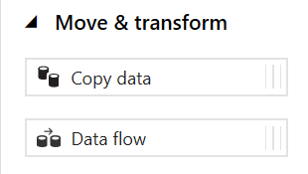
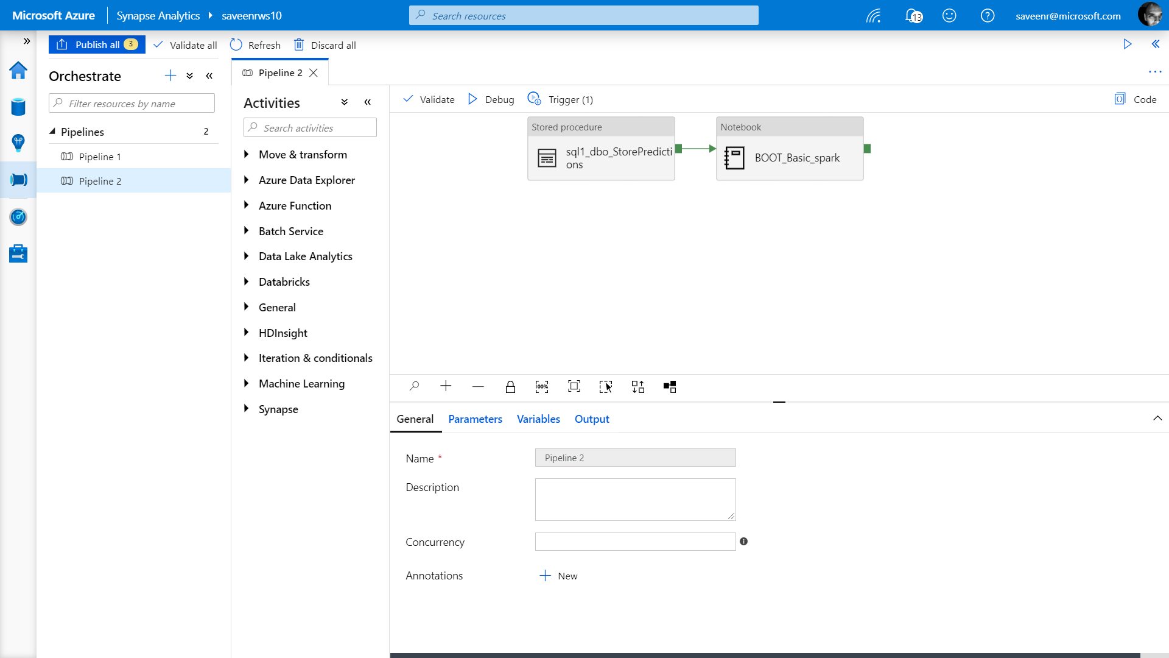
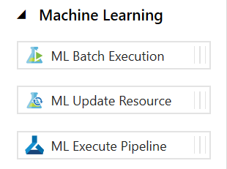
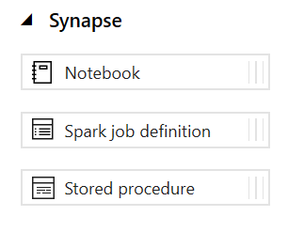
Pipelines
Create pipelines to ingest, transform and load data with 90+ inbuilt connectors.
Offers a wide range of activities that a pipeline can perform.

Slide 11
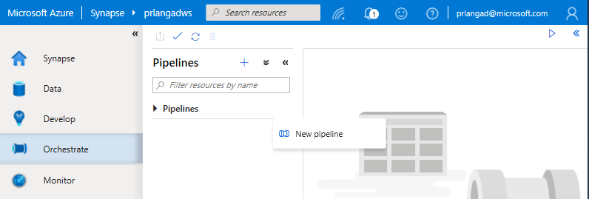
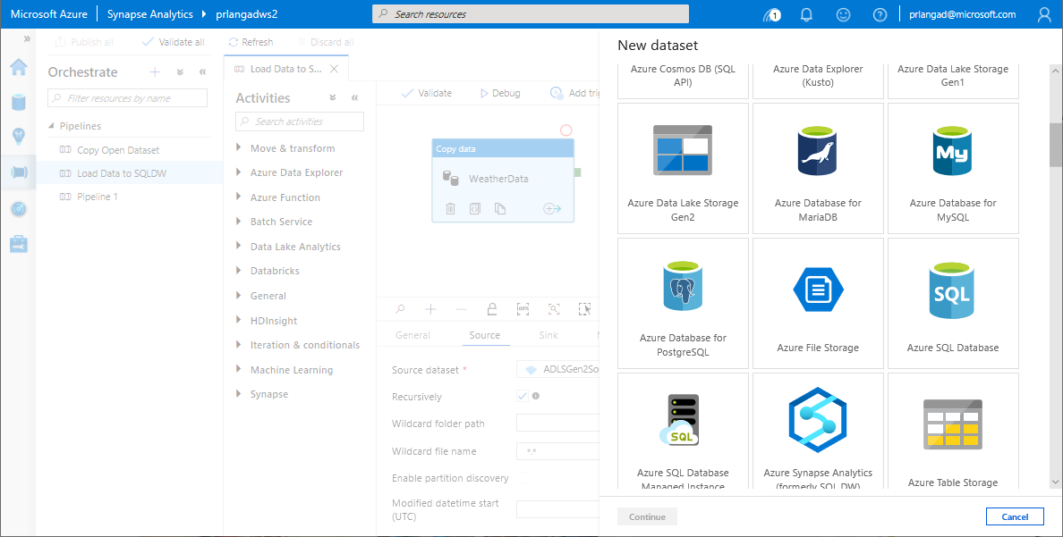
Pipelines
Overview
Provide ability to load data from storage account to desired linked service.
Load data by manual execution of pipeline or by orchestration.
Benefits
Supports common loading patterns.
Fully parallel loading into data lake or SQL tables.
Graphical development experience.

Slide 12
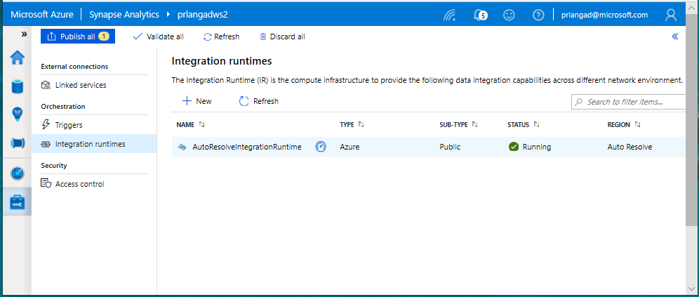
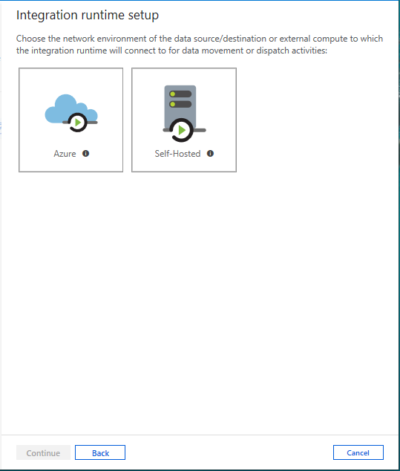
Integration runtimes
Overview
Integration runtimes are the compute infrastructure used by Pipelines to provide the data integration capabilities across different network environments. An integration runtime provides the bridge between the activity and linked services.
Benefits
Offers Azure Integration Runtime or Self-Hosted Integration Runtime
Azure Integration Runtime – provides fully managed, serverless compute in Azure
Self-Hosted Integration Runtime – use compute resources in on-premises machine or a VM inside private network
Notes:
Need to explain and why needed
Check with Gaurav

Slide 13
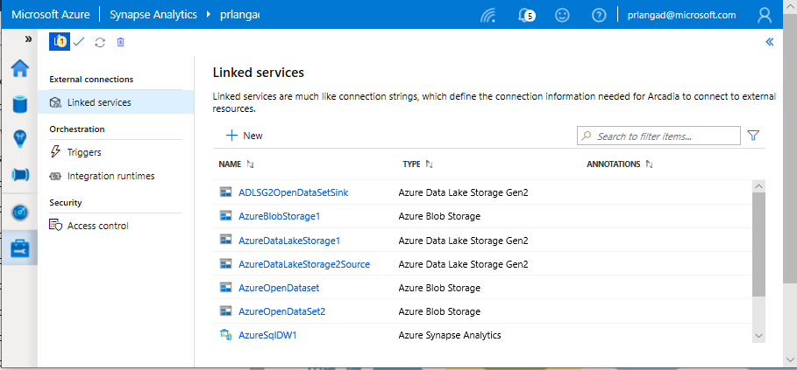
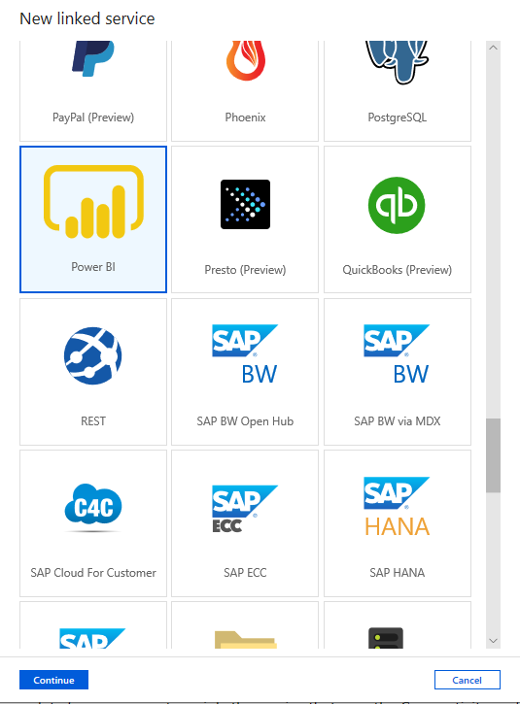
Linked services
Overview
Linked services define the connection information needed to connect to external resources.
Benefits
Offers pre-build 90+ connectors
Easy cross platform data migration
Represents data store or compute resources

Slide 14
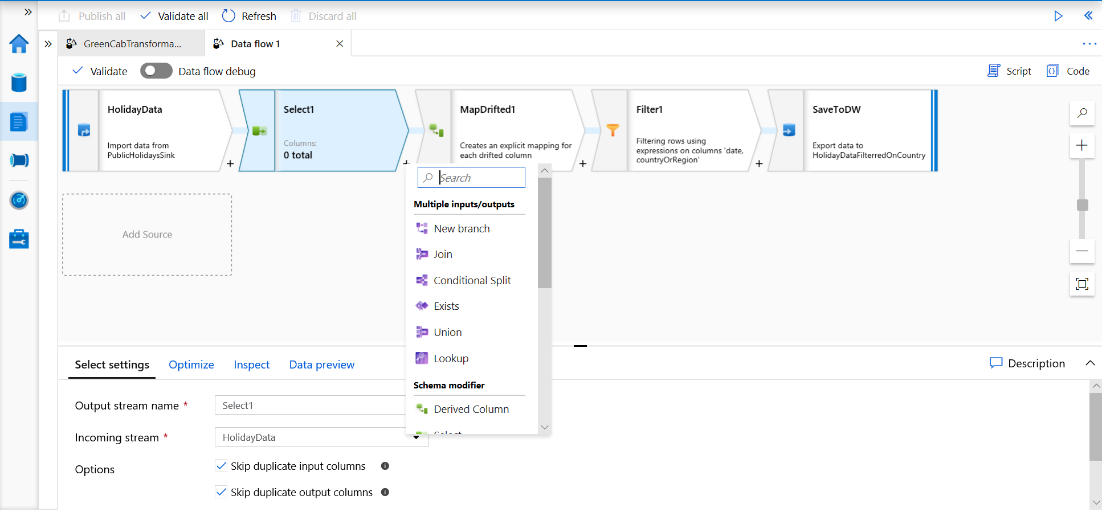
Develop Hub - Data Flows
Data flows are a visual way of specifying how to transform data.
Provides a code-free experience.

Slide 15
Data Flow Capabilities
Handle upserts, updates, deletes on sql sinks
Add new partition methods
Add schema drift support
Add file handling (move files after read, write files to file names described in rows etc)
New inventory of functions (for e.g Hash functions for row comparison)
Commonly used ETL patterns(Sequence generator/Lookup transformation/SCD…)
Data lineage – Capturing sink column lineage & impact analysis(invaluable if this is for enterprise deployment)
Implement commonly used ETL patterns as templates(SCD Type1, Type2, Data Vault)

Slide 16
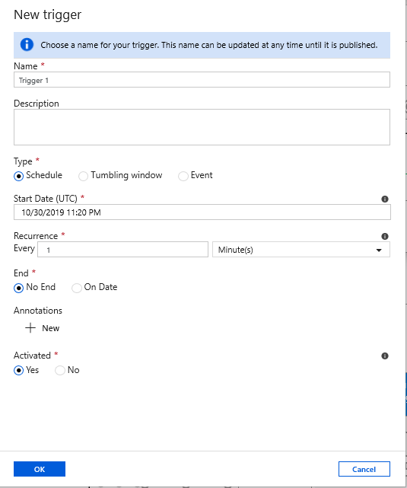
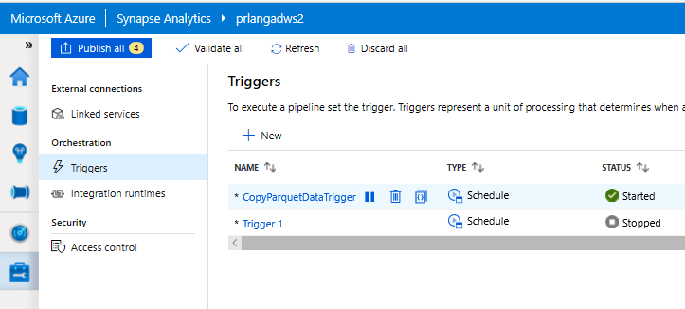
Triggers
Overview
Triggers represent a unit of processing that determines when a pipeline execution needs to be kicked off.
Data Integration offers 3 trigger types as –
Schedule – gets fired at a schedule with information of start date, recurrence, end date
Event – gets fired on specified Storage event
Tumbling window – gets fired at a periodic time interval from a specified start date, while retaining state
It also provides ability to monitor pipeline runs and control trigger execution.

Slide 17
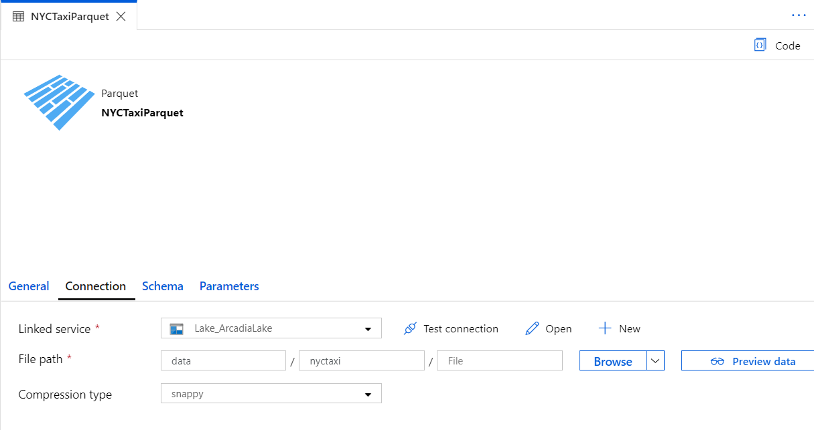
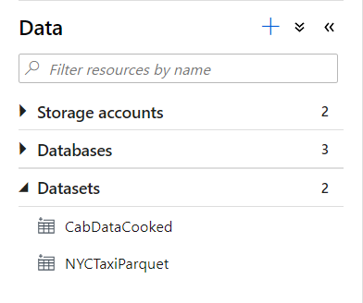
Datasets
Orchestration datasets describe data that is persisted.
Once a dataset is defined, it can be used in pipelines and sources of data or as sinks of data.

Slide 18
90+ Connectors out of the box
Azure (15) | Database & DW (26) |  | File Storage (6) | File Formats(6) | NoSQL (3) | Services and App (28) |  | Generic (4)
Blob storage | Amazon Redshift | Oracle | Amazon S3 | AVRO | Cassandra | Amazon MWS | Oracle Service Cloud | Generic HTTP
Cosmos DB - SQL API | DB2 | Phoenix | File system | Binary | Couchbase | CDS for Apps | PayPal | Generic OData
Cosmos DB - MongoDB API | Drill | PostgreSQL | FTP | Delimited Text | MongoDB | Concur | QuickBooks | Generic ODBC
Data Explorer | Google BigQuery | Presto | Google Cloud Storage | JSON |  | Dynamics 365 | Salesforce | Generic REST
Data Lake Storage Gen1 | Greenplum | SAP BW Open Hub | HDFS | ORC |  | Dynamics AX | SF Service Cloud
Data Lake Storage Gen2 | HBase | SAP BW via MDX | SFTP | Parquet |  | Dynamics CRM | SF Marketing Cloud
Database for MariaDB | Hive | SAP HANA |  |  |  | Google AdWords | SAP C4C
Database for MySQL | Apache Impala | SAP table |  |  |  | HubSpot | SAP ECC
Database for PostgreSQL | Informix | Spark |  |  |  | Jira | ServiceNow
File Storage | MariaDB | SQL Server |  |  |  | Magento | Shopify
SQL Database | Microsoft Access | Sybase |  |  |  | Marketo | Square
SQL Database MI | MySQL | Teradata |  |  |  | Office 365 | Web table
SQL Data Warehouse | Netezza | Vertica |  |  |  | Oracle Eloqua | Xero
Search index |  |  |  |  |  | Oracle Responsys | Zoho
Table storage
Notes:
formatting

Slide 19
Pop Quiz
Which one of these is NOT a component of a Synapse pipeline?
A) I.R.
B)
Linked Service
C)
Table
D) Activity

Slide 20
Pop Quiz
Which one of these is NOT a component of a Synapse pipeline?
A) I.R.
B)
Linked Service
C)
Table
D) Activity

Slide 21
Ingesting files into tables

Slide 22
COPY command
Overview
Copies data from source to destination
Benefits
Retrieves data from all files from the folder and all its subfolders.
Supports multiple locations from the same storage account, separated by comma
Supports Azure Data Lake Storage (ADLS) Gen 2 and Azure Blob Storage.
Supports CSV, PARQUET, ORC file formats
COPY INTO test_1
FROM 'https://XYZ.blob.core.windows.net/customerdatasets/test_1.txt'
WITH (
FILE_TYPE = 'CSV',
CREDENTIAL=(IDENTITY= 'Shared Access Signature', SECRET='<Your_SAS_Token>'),
FIELDQUOTE = '"',
FIELDTERMINATOR=';',
ROWTERMINATOR='0X0A',
ENCODING = 'UTF8',
DATEFORMAT = 'ymd',
MAXERRORS = 10,
ERRORFILE = '/errorsfolder/'--path starting from the storage container,
IDENTITY_INSERT
)
COPY INTO test_parquet
FROM 'https://XYZ.blob.core.windows.net/customerdatasets/test.parquet'
WITH (
FILE_FORMAT = myFileFormat
CREDENTIAL=(IDENTITY= 'Shared Access Signature', SECRET='<Your_SAS_Token>')
)

Slide 23
Create External Table As Select (Polybase)
-- Create a database master key if one does not already exist
CREATE MASTER KEY ENCRYPTION BY PASSWORD = 'S0me!nfo'
;
-- Create a database scoped credential with Azure storage account key as the secret.
CREATE DATABASE SCOPED CREDENTIAL AzureStorageCredential
WITH
IDENTITY = '<my_account>'
, SECRET = '<azure_storage_account_key>'
;
-- Create an external data source with CREDENTIAL option.
CREATE EXTERNAL DATA SOURCE MyAzureStorage
WITH
( LOCATION = 'wasbs://daily@logs.blob.core.windows.net/'
, CREDENTIAL = AzureStorageCredential
, TYPE = HADOOP
)
-- Create an external file format
CREATE EXTERNAL FILE FORMAT MyAzureCSVFormat
WITH (FORMAT_TYPE = DELIMITEDTEXT,
FORMAT_OPTIONS(
FIELD_TERMINATOR = ',',
FIRST_ROW = 2)
--Create an external table
CREATE EXTERNAL TABLE dbo.FactInternetSalesNew
WITH(
LOCATION = '/files/Customer',
DATA_SOURCE = MyAzureStorage,
FILE_FORMAT = MyAzureCSVFormat
)
AS SELECT T1.* FROM dbo.FactInternetSales T1 JOIN dbo.DimCustomer T2
ON ( T1.CustomerKey = T2.CustomerKey )
OPTION ( HASH JOIN );
Overview
Creates an external table and then exports results of the Select statement. These operations will import data into the database for the duration of the query
Steps:
Create Master Key
Create Credentials
Create External Data Source
Create External Data Format
Create External Table

Slide 24
Polybase vs Copy
Polybase
Copy
Currently in Preview
Relaxed permission
Slightly slower, but improving
No row width limit
Supports delimiters in text
Supports custom column and row delimiters
GA, stable
Needs CONTROL permission
Fastest (at present)
Enables querying via external tables
Challenges:
Row width
Delimiters in text
Fixed line delimiter
Code complexity

Slide 25
Best Practices for Ingest

Slide 26
Ingest Flat files to tables
Ingest flat file data into Azure Storage (Azure Data Lake Store Gen2)
When your data sources are on-premises, you need to move the data to Azure Storage before ingestion.
Data in other cloud platforms needs to be moved to Azure Storage before ingestion.
Load from flat files as relational tables within the data warehouse
Notes:
What specific approach would you say is the most efficient way for moving flat file data from the ingest storage locations to the data lake?
Follow the pattern of landing data in the data lake first, then ingest from the flat files into relational tables within the data warehouse. Then create pipelines that extract the source data and store in Azure Data Lake Store Gen2 as Parquet files.
What storage service would you recommend to use?
They should use Azure Data Lake Store (ADLS) Gen2 (Azure Storage with hierarchical file systems).

Slide 27
Ingest - Structuring ADLS Gen2
Separate storage accounts for each environment: dev, test, & production.
Use a common folder structure to organize data by degree of refinement.
ADLS Gen 2 Filesystem
Raw Data
/bronze
Query Ready
/silver
Report Ready
/gold
Notes:
How would you recommend to structure the folder to manage the data at the various levels of refinement?
They should use Azure Data Lake Store (ADLS) Gen2 (Azure Storage with hierarchical file systems).
In ADLS, it is a best practice to have a dedicated Storage Account for production, and a separate Storage Account for dev and test workloads. This will ensure that dev or test workloads never interfere with production.
One common folder structure is to organize the data in separate folders by degree of refinement. For example a bronze folder contains the raw data, silver contains the cleaned, prepared and integrated data and gold contains data ready to support analytics, which might include final refinements such as pre-computed aggregates.

Slide 28
Ingest from on-premises data sources
Fastest is done by batch:
Extract from data source to multiple CSV/Parquet files
Use AzCopy to upload to ADLS
Alternative is query-insert:
Set up SSIS self-hosted integration runtime on-premises
Use Synapse Pipeline to extract/copy
Use Synapse Pipeline to execute load procedure
Large Migrations:
Use Azure Data Box where available

Slide 29
Ingest from Cloud Data Sources
Options:
Extract using Synapse Pipelines
Write to ADLS as Parquet files
AzCopy is a fast move for files from S3 to ADLS

Slide 30
Ingest File Data Sources
Look out for these file format challenges…
Invalid file format
Multiple row types
Ragged columns
Row size > 1Mb
Datetime format/s (e.g., use of nanosecond date time)
NULL value literal/s
Free form text
Parquet partitions
XML data
Use of non-standard line delimiters (e.g., CR)
…and try these Solutions
Use Spark to pre-process and fix data errors
Flatten and parse XML in Spark
Use COPY to ingest complex CSV instead of Polybase

Slide 31
Ingest and Store – Formats
For batch flat files, Azure Synapse Analytics supports CSV, Parquet, ORC, and JSON formats.
Ingest streaming data messages/events via Event Hub or IoT Hub.
Parquet format recommended for storing ingested data at various levels of refinement.
Notes:
When it comes to ingesting raw data in batch from new data sources, what data formats are supported by Synapse?
CSV, Parquet, ORC, JSON
How do you ingest streaming data?
Collect messages in Event Hub or IoT Hub and process them with Stream Analytics.
Azure offers purpose-built stream ingestion services such as Azure Kafka and Azure Event Hubs that are robust, proven and performant.
(Preview) Azure Synapse will also support native stream ingestion through integration with Azure Stream Analytics.
When it comes to storing refined versions of the data for possible querying, what data format would you recommend they use? Why?
Parquet. There is industry alignment around the Parquet format for sharing data at the storage layer (e.g., across Hadoop, Databricks, and SQL engine scenarios). Parquet is a high-performance, column oriented format optimized for big data scenarios.

Slide 32
Ingest - When to BCP / Bulk Copy
Green fields: Never
Network unreliability, no retries
Needs VM in cloud, performance dependent on VM configuration
Doesn’t support ADLS
Reduces concurrency
Control-gated performance limitation, can not scale with DWU
Migrations:
Use Synapse Pipeline or AzCopy
Bulk Copy will work, but it will be slower than other methods

Slide 33
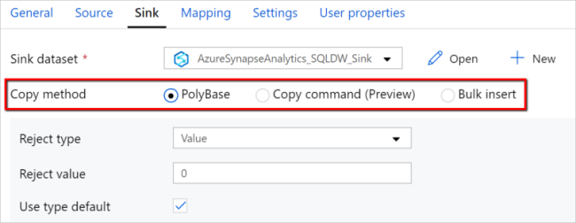
Ingest – Synapse Pipelines
Un-check USE TYPE DEFAULT, it is not a best practice.
Land data in ADLS Gen2, then ingest using Polybase / COPY.
This means you can re-ingest the same data set without having to repeat extracts, and better demonstrate ingestion performance.
Notes:
https://docs.microsoft.com/en-us/azure/data-factory/connector-azure-sql-data-warehouse#polybase-troubleshooting <- a good resource to share out as well
Lino 68

Slide 34
Ingest and Store – Loading staging tables
Indexing
Use Heap tables
Speed load performance by staging data in heap tables and temporary tables prior to running transformations.
Only load to a CCI table if the test requires a load to a single table, then complex end-user queries against that table.
as
Notes:
What should you use for the fastest loading of staging tables?
A heap table. If you are loading data only to stage it before running more transformations, loading the table to heap table is much faster than loading the data to a clustered columnstore table.
A temporary table. Loading data to a temporary table loads faster than loading a table to permanent storage.

Slide 35
Ingest and Store – Loading staging tables
Distribution
Use Round Robin Distribution for:
Potentially useful tables created from raw input.
Temporary staging tables used in data preparation.
Other distribution considerations:
Never load to a REPLICATED table
Load to a ROUND_ROBIN table if the test is ONLY raw ingestion performance, or if the table is very small
Load to a HASH table if the test is a pipeline with subsequent transformations using the loaded table
Notes:
How should you configure table distribution for tables created from the raw input that might be useful, or tables used for staging?
Consider round-robin distribution.
A round-robin distributed table distributes table rows evenly across all distributions. The assignment of rows to distributions is random. Unlike hash-distributed tables, rows with equal values are not guaranteed to be assigned to the same distribution.
As a result, the system sometimes needs to invoke a data movement operation to better organize your data before it can resolve a query. This extra step can slow down your queries. For example, joining a round-robin table usually requires reshuffling the rows, which is a performance hit.
Consider using the round-robin distribution for your table in the following scenarios:
When getting started as a simple starting point since it is the default
If there is no obvious joining key
If there is not good candidate column for hash distributing the table
If the table does not share a common join key with other tables
If the join is less significant than other joins in the query
When the table is a temporary staging table

Slide 36
Ingest – Scaling to shorten duration
Ingestion duration is correlated with the number of DWU’s allocated to the SQL Pool.
For every doubling of the DWU’s you halve the ingestion time.
2d = t/2
d: DWU
T: ingestion time
Only applies from DWU500c – DWU30000c

Slide 37
Pop Quiz
True or False: Both COPY command AND Polybase require CONTROL permission
TRUE
FALSE

Slide 38
Pop Quiz
True or False: Both COPY command AND Polybase require CONTROL permissions
TRUE
FALSE
Notes:
FALSE – only Polybase requires CONTROL permission

Slide 39
Modern Data Warehouse
INGEST
PREPARE
TRANSFORM & ENRICH
SERVE
VISUALIZE
STORE

Slide 40









Modern Data Warehouse
INGEST
PREPARE
TRANSFORM & ENRICH
SERVE
VISUALIZE
AZURE SYNAPSE ANALYTICS
Synapse SQL (Provisioned)
Synapse Pipeline
Synapse SQL (Provisioned)
Data Sources
Synapse SQL (Serverless)
Synapse Pipeline
Power BI
OR
OR
Synapse Pipelines
Synapse SQL (Serverless)
Synapse Spark
Synapse Spark
Synapse SQL (Serverless)
STORE
ADLS Gen 2
Storage Account
Data Lake

Slide 41
Thank You slide
Thank you

Slide 42
Data Transformations

Slide 43
Agenda
1 Transform with Pipelines
Understanding and exploring the data.
2 Serverless transforms
Use Azure Synapse SQL Serverless to transform data with SQL scripts.
3 Transform with Spark
Here we have an example of what the agenda item would look like.
4 Best practices
Best practices for data transformation.

Slide 44
Typical Data Transformations
Create persistent staging area / data vault
Standardize data from different sources
Remove duplicate rows
Impute missing values
Calculate derived values
Prepare data for facts and dimensions

Slide 45
Applying transformations

Slide 46
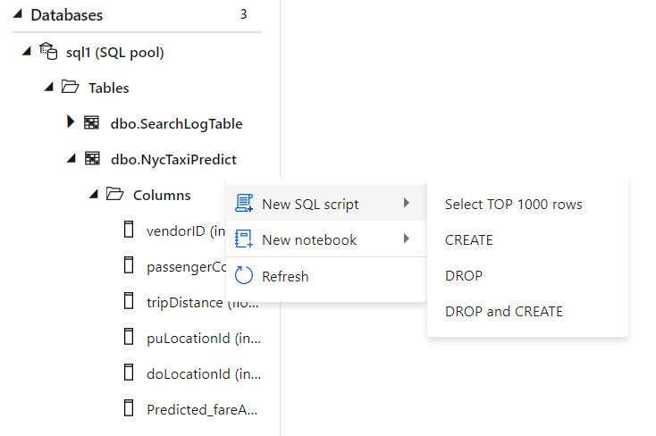
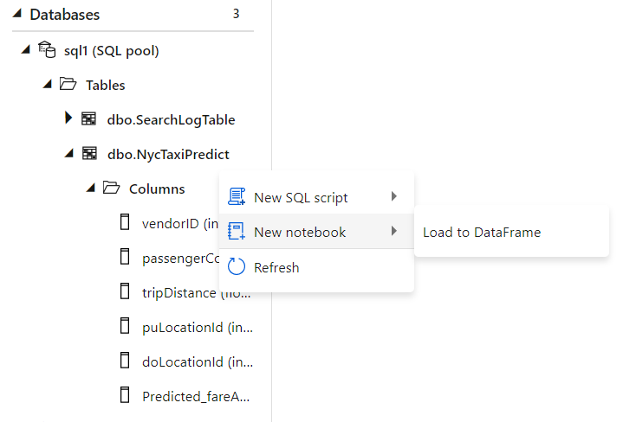
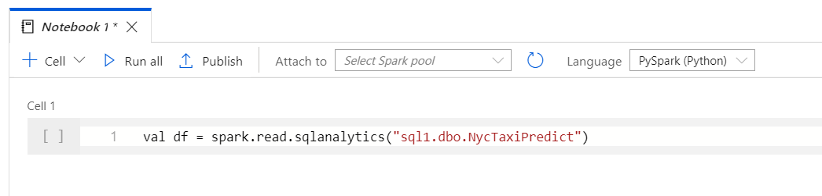
Code based transformations
Starting from a table, auto-generate a single line of PySpark code that makes it easy to load a SQL table into a Spark dataframe​ and author transforms in a notebook.
Familiar gesture to generate T-SQL scripts from SQL metadata objects such as tables.

Slide 47
Transform with Pipelines
Orchestrate transformations with Synapse Pipelines.

Slide 48
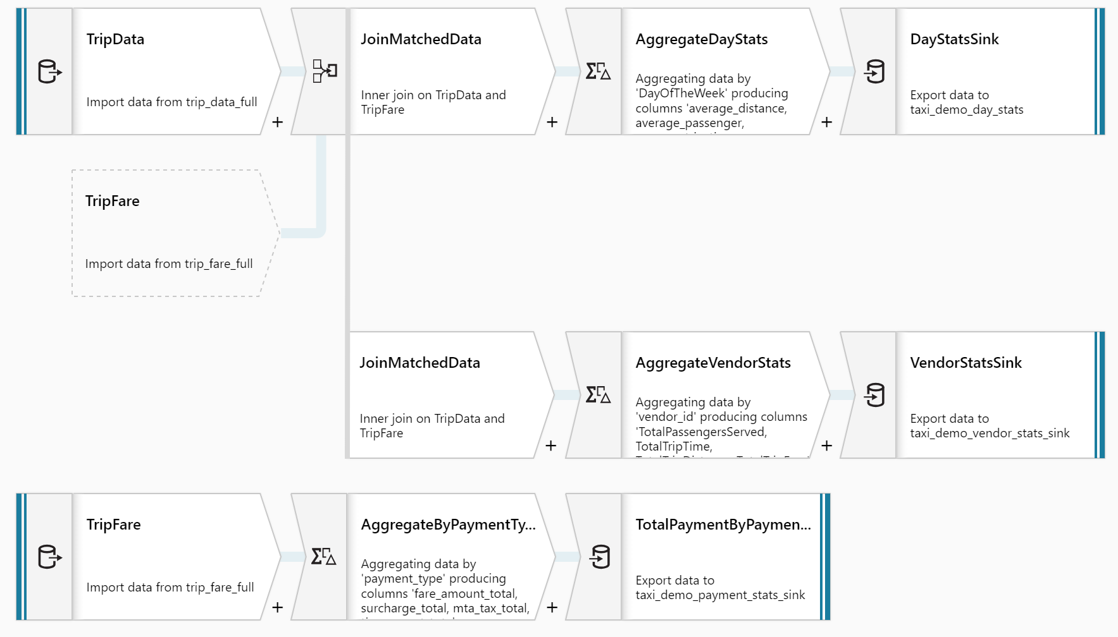
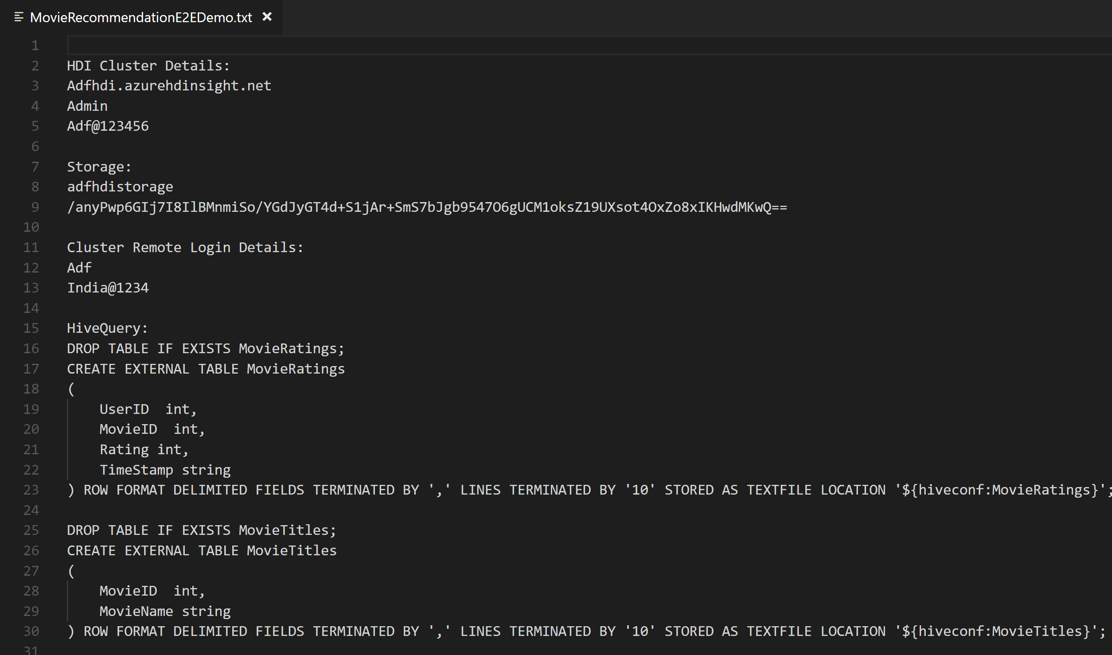
No Code Transform with Mapping Data Flows
Overview
It offers data cleansing, transformation, aggregation, conversion, etc.
Benefits
Cloud scale via Spark execution
Guided experience to easily build resilient data flows
Flexibility to transform data per user’s comfort
Monitor and manage dataflows from a single pane of glass
This…
NOT this…

Slide 49
Transform with Serverless

Slide 50
Pop Quiz
What’s the largest scale TPC-H workload SQL Serverless has successfully run?
A)
100TB
B)
1PB
C)
10PB

Slide 51
Pop Quiz
What’s the largest scale TPC-H workload SQL Serverless has successfully run?
A)
100TB
B)
1PB
C)
10PB

Slide 52





Serverless SQL Pool
Overview
An interactive query service that provides T-SQL queries over high scale data in Azure Storage.
Benefits
Pay-per-query with serverless model
Query data in-place on the data lake with T-SQL (no ETL)
Supports various file formats (Parquet, CSV, JSON)
Integrates with Databricks, HDInsight, PowerBI, and the shared Synapse metastore
Power BI
Curate and transform data
SQL On Demand Query
Azure Data Studio
Sync table definitions
Read and write
data files
SSMS
Read and write
data files
10
01
Azure Storage

Slide 53
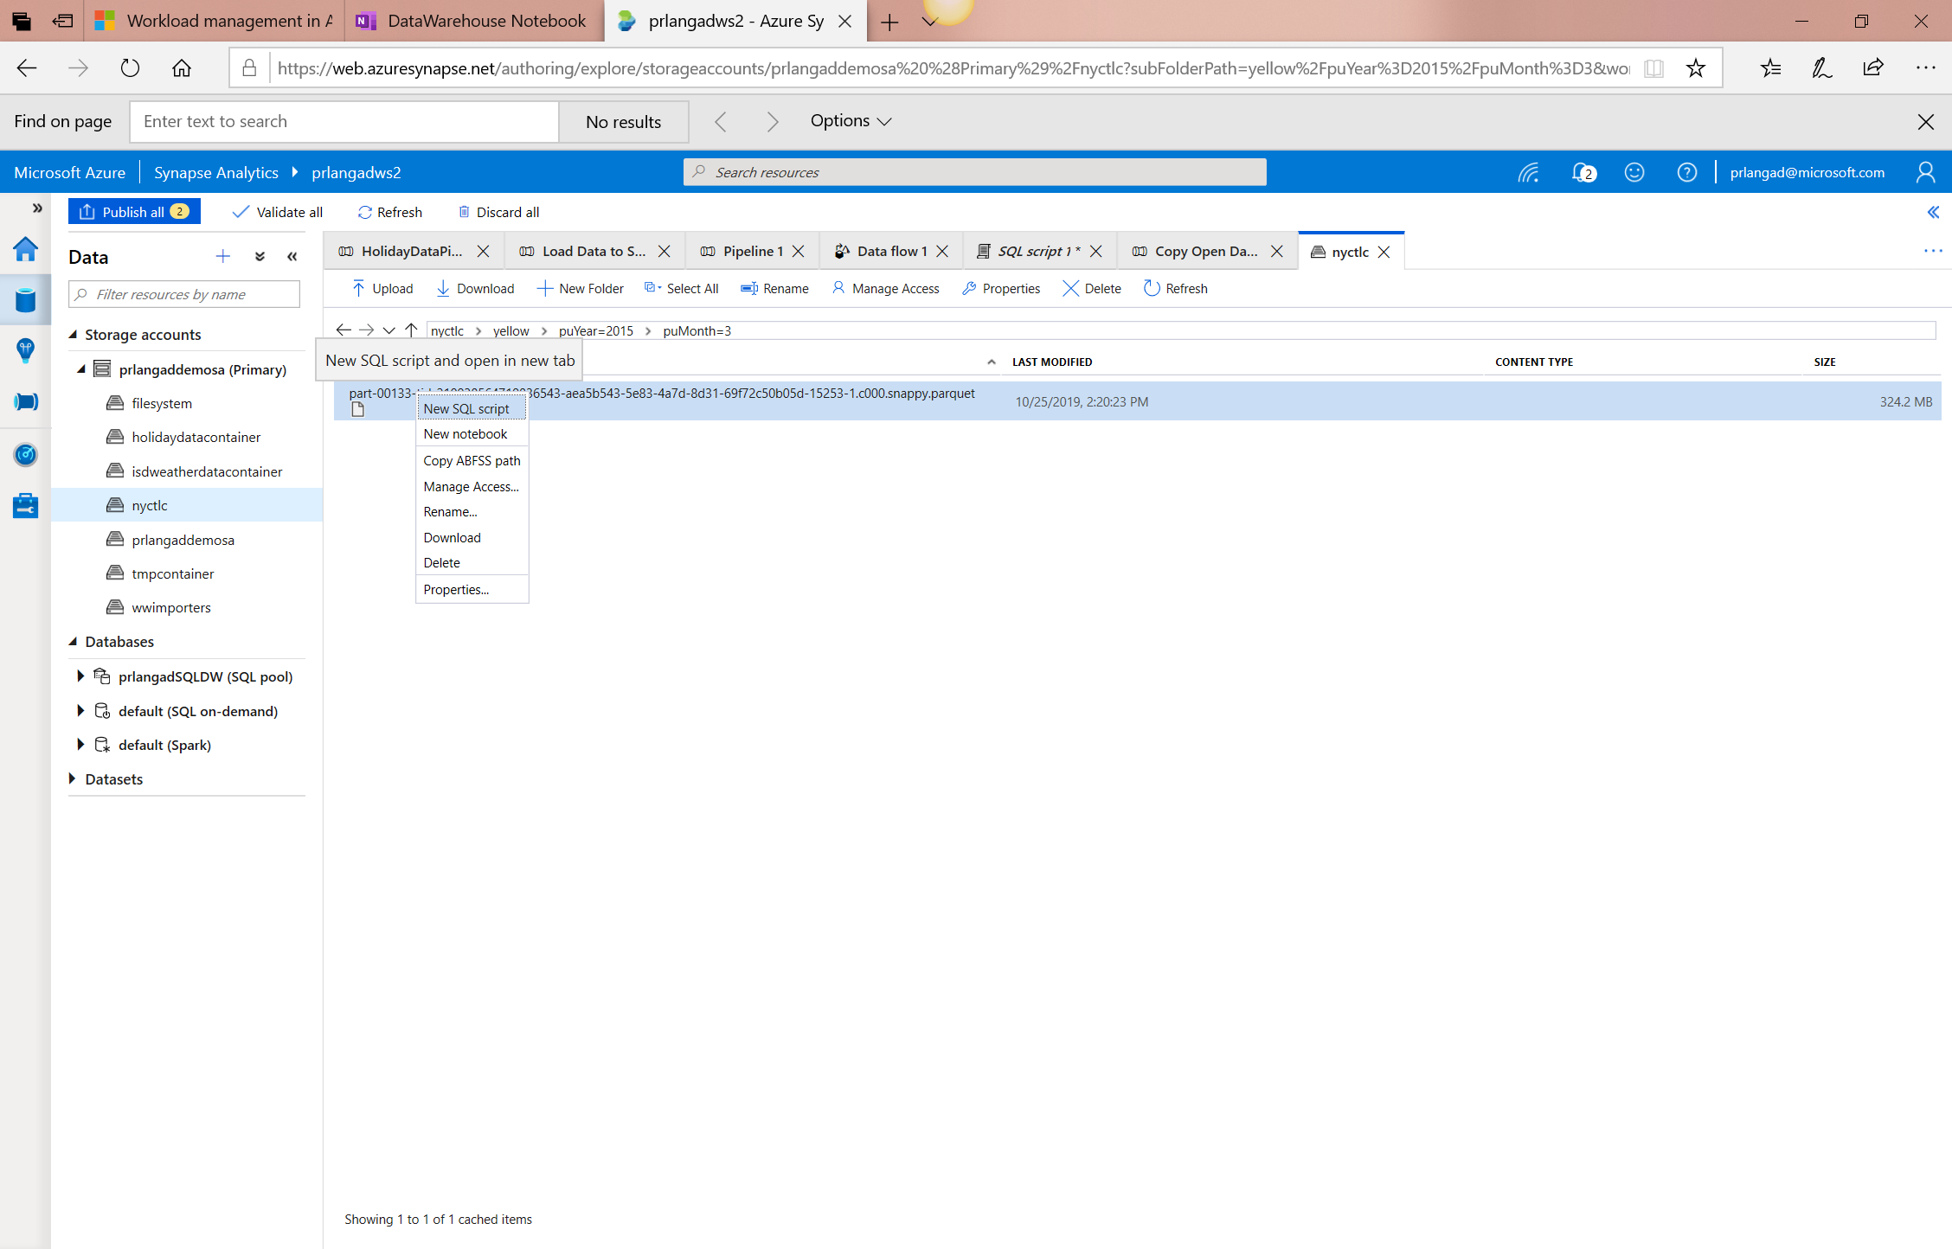
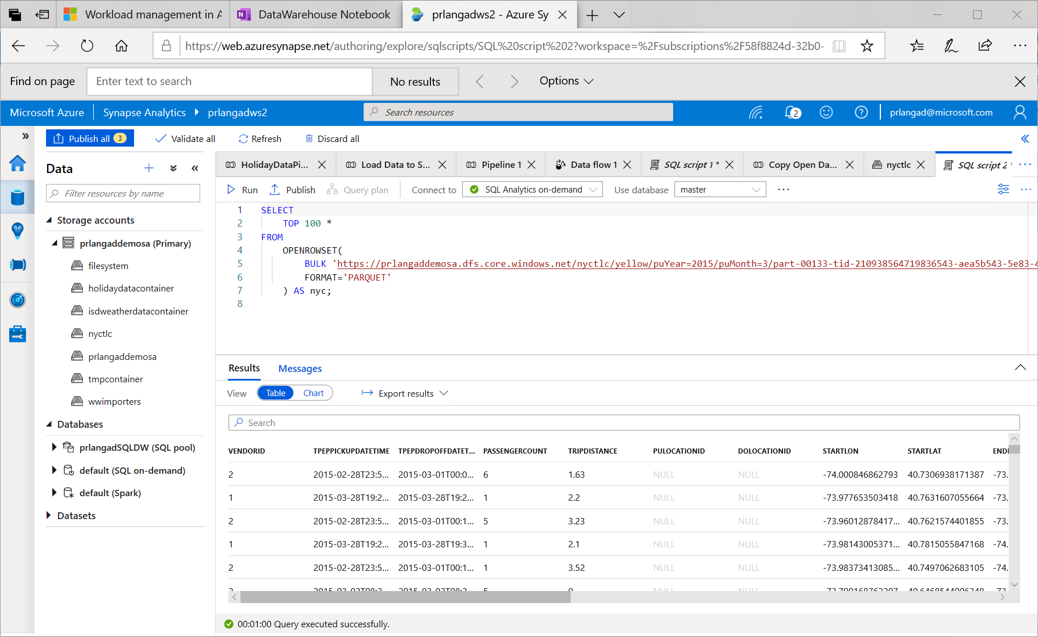
Serverless SQL – Querying on storage

Slide 54
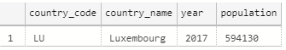
Serverless SQL – Querying CSV File
Overview
Uses OPENROWSET function to access data
Benefits
Ability to read CSV File with
- no header row, Windows style new line
- no header row, Unix-style new line
- header row, Unix-style new line
- header row, Unix-style new line, quoted
- header row, Unix-style new line, escape
- header row, Unix-style new line, tab-delimited
- without specifying all columns
SELECT *
FROM OPENROWSET(
BULK 'https://XXX.blob.core.windows.net/csv/population/population.csv',
FORMAT = 'CSV',
FIELDTERMINATOR =',',
ROWTERMINATOR = '\n'
)
WITH (
[country_code] VARCHAR (5) COLLATE Latin1_General_BIN2,
[country_name] VARCHAR (100) COLLATE Latin1_General_BIN2,
[year] smallint,
[population] bigint
) AS [r]
WHERE
country_name = 'Luxembourg'
AND year = 2017

Slide 55
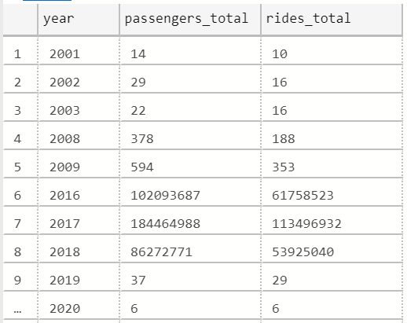
Serverless SQL – Querying folders
Overview
Uses OPENROWSET function to access data from
multiple files or folders
Benefits
Offers reading multiple files/folders through usage of wildcards
Offers reading specific file/folder
Supports use of multiple wildcards
SELECT YEAR(pickup_datetime) as [year], SUM(passenger_count) AS passengers_total, COUNT(*) AS [rides_total]
FROM OPENROWSET(
BULK 'https://XXX.blob.core.windows.net/csv/taxi/*.*’,
FORMAT = 'CSV’
, FIRSTROW = 2 )
WITH (
vendor_id VARCHAR(100) COLLATE Latin1_General_BIN2,
pickup_datetime DATETIME2,
dropoff_datetime DATETIME2,
passenger_count INT,
trip_distance FLOAT,
rate_code INT,
store_and_fwd_flag VARCHAR(100) COLLATE Latin1_General_BIN2,
pickup_location_id INT,
dropoff_location_id INT,
payment_type INT,
fare_amount FLOAT,
extra FLOAT, mta_tax FLOAT,
tip_amount FLOAT,
tolls_amount FLOAT,
improvement_surcharge FLOAT,
total_amount FLOAT
) AS nyc
GROUP BY YEAR(pickup_datetime)
ORDER BY YEAR(pickup_datetime)

Slide 56
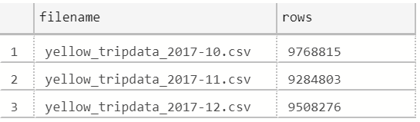
Serverless SQL – Querying specific files
Overview
filename – Provides file name that originates row result
filepath – Provides full path when no parameter is passed or part of path when parameter is passed that originates result
Benefits
Provides source name/path of file/folder for row result set
Example of filename function
SELECT
r.filename() AS [filename]
,COUNT_BIG(*) AS [rows]
FROM OPENROWSET(
BULK 'https://XXX.blob.core.windows.net/csv/taxi/yellow_tripdata_2017-1*.csv’,
FORMAT = 'CSV',
FIRSTROW = 2
)
WITH (
vendor_id INT,
pickup_datetime DATETIME2,
dropoff_datetime DATETIME2,
passenger_count SMALLINT,
trip_distance FLOAT,
<…columns>
) AS [r]
GROUP BY r.filename()
ORDER BY [filename]

Slide 57
Serverless SQL – Querying specific files
Example of filepath function
SELECT
r.filepath() AS filepath
,r.filepath(1) AS [year]
,r.filepath(2) AS [month]
,COUNT_BIG(*) AS [rows]
FROM OPENROWSET(
BULK 'https://XXX.blob.core.windows.net/csv/taxi/yellow_tripdata_*-*.csv’,
FORMAT = 'CSV',
FIRSTROW = 2 )
WITH (
vendor_id INT,
pickup_datetime DATETIME2,
dropoff_datetime DATETIME2,
passenger_count SMALLINT,
trip_distance FLOAT,
<… columns>
) AS [r]
WHERE r.filepath(1) IN ('2017’)
AND r.filepath(2) IN ('10', '11', '12’)
GROUP BY r.filepath() ,r.filepath(1) ,r.filepath(2)
ORDER BY filepath
filepath | year | month | rows
https://XXX.blob.core.windows.net/csv/taxi/yellow_tripdata_2017-10.csv | 2017 | 10 | 9768815
https://XXX.blob.core.windows.net/csv/taxi/yellow_tripdata_2017-11.csv | 2017 | 11 | 9284803
https://XXX.blob.core.windows.net/csv/taxi/yellow_tripdata_2017-12.csv | 2017 | 12 | 9508276

Slide 58
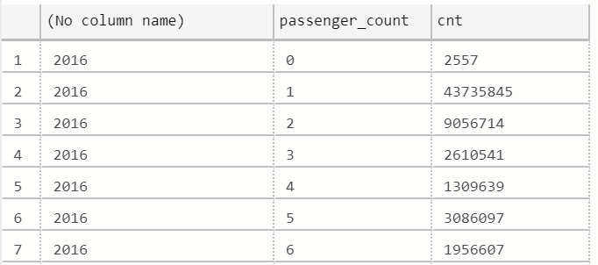
Serverless SQL – Querying Parquet files
Overview
Uses OPENROWSET function to access data
Benefits
Ability to specify column names of interest
Offers auto reading of column names and data types
Provides target specific partitions using filepath function
SELECT
YEAR(pickup_datetime),
passenger_count,
COUNT(*) AS cnt
FROM
OPENROWSET(
BULK 'https://XXX.blob.core.windows.net/parquet/taxi/*/*/*',
FORMAT='PARQUET'
) WITH (
pickup_datetime DATETIME2,
passenger_count INT
) AS nyc
GROUP BY
passenger_count,
YEAR(pickup_datetime)
ORDER BY
YEAR(pickup_datetime),
passenger_count

Slide 59
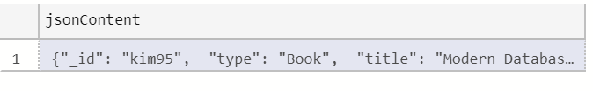
Serverless SQL – Querying JSON files
Overview
Read JSON files and provides data in tabular format
Benefits
Supports OPENJSON, JSON_VALUE and JSON_QUERY functions
SELECT *
FROM
OPENROWSET(
BULK 'https://XXX.blob.core.windows.net/json/books/book1.json’,
FORMAT='CSV',
FIELDTERMINATOR ='0x0b',
FIELDQUOTE = '0x0b',
ROWTERMINATOR = '0x0b'
)
WITH (
jsonContent varchar(8000)
) AS [r]

Slide 60
Serverless SQL – Querying JSON files
Example of JSON_VALUE function
Example of JSON_QUERY function
SELECT
JSON_VALUE(jsonContent, '$.title') AS title,
JSON_VALUE(jsonContent, '$.publisher') as publisher,
jsonContent
FROM
OPENROWSET(
BULK 'https://XXX.blob.core.windows.net/json/books/*.json',
FORMAT='CSV',
FIELDTERMINATOR ='0x0b',
FIELDQUOTE = '0x0b',
ROWTERMINATOR = '0x0b'
)
WITH (
jsonContent varchar(8000)
) AS [r]
WHERE
JSON_VALUE(jsonContent, '$.title') = 'Probabilistic and Statistical Methods in Cryptology, An Introduction by Selected Topics'
SELECT
JSON_QUERY(jsonContent, '$.authors') AS authors,
jsonContent
FROM
OPENROWSET(
BULK 'https://XXX.blob.core.windows.net/json/books/*.json',
FORMAT='CSV',
FIELDTERMINATOR ='0x0b',
FIELDQUOTE = '0x0b',
ROWTERMINATOR = '0x0b'
)
WITH (
jsonContent varchar(8000)
) AS [r]
WHERE
JSON_VALUE(jsonContent, '$.title') = 'Probabilistic and Statistical Methods in Cryptology, An Introduction by Selected Topics'

Slide 61
Transform with Spark

Slide 62
Transforming with Spark – Querying SQL Pools
Existing Approach
New Approach Using Scala
val jdbcUsername = "<SQL DB ADMIN USER>"
val jdbcPwd = "<SQL DB ADMIN PWD>"
val jdbcHostname = "servername.database.windows.net”
val jdbcPort = 1433
val jdbcDatabase ="<AZURE SQL DB NAME>“
val jdbc_url = s"jdbc:sqlserver://${jdbcHostname}:${jdbcPort};database=${jdbcDatabase};encrypt=true;trustServerCertificate=false;hostNameInCertificate=*.database.windows.net;loginTimeout=60;“
val connectionProperties = new Properties()
connectionProperties.put("user", s"${jdbcUsername}")
connectionProperties.put("password", s"${jdbcPwd}")
val sqlTableDf = spark.read.jdbc(jdbc_url, “dbo.Tbl1", connectionProperties)
// Construct a Spark DataFrame from SQL Pool table
var df = spark.read.sqlanalytics("sql1.dbo.Tbl1")
// Write the Spark DataFrame into SQL Pool table
df.write.sqlanalytics(“sql1.dbo.Tbl2”)
Using Python
%%spark
val df = spark.read.sqlanalytics("sql1.dbo.Tbl1")
df.createOrReplaceTempView("tbl1")
%%pyspark
sample = spark.sql("SELECT * FROM tbl1")
sample.createOrReplaceTempView("tblnew")
%%spark
val df = spark.sql("SELECT * FROM tblnew")
df.write.sqlanalytics(“sql1.dbo.tbl2", Constants.INTERNAL)
Notes:
Important Points:
No need to pre-create the table in the SQL Pool to write to, it will be created if it does not exist.
sqlanalytics only works in Scala language cells.
To read with other languages like Python, use Spark to register a temporary view and then query the view using Spark.SQL(“select * from viewname”)
To write with other languages, create a view for table you want write, then query from that view in Scala. Then write.

Slide 63
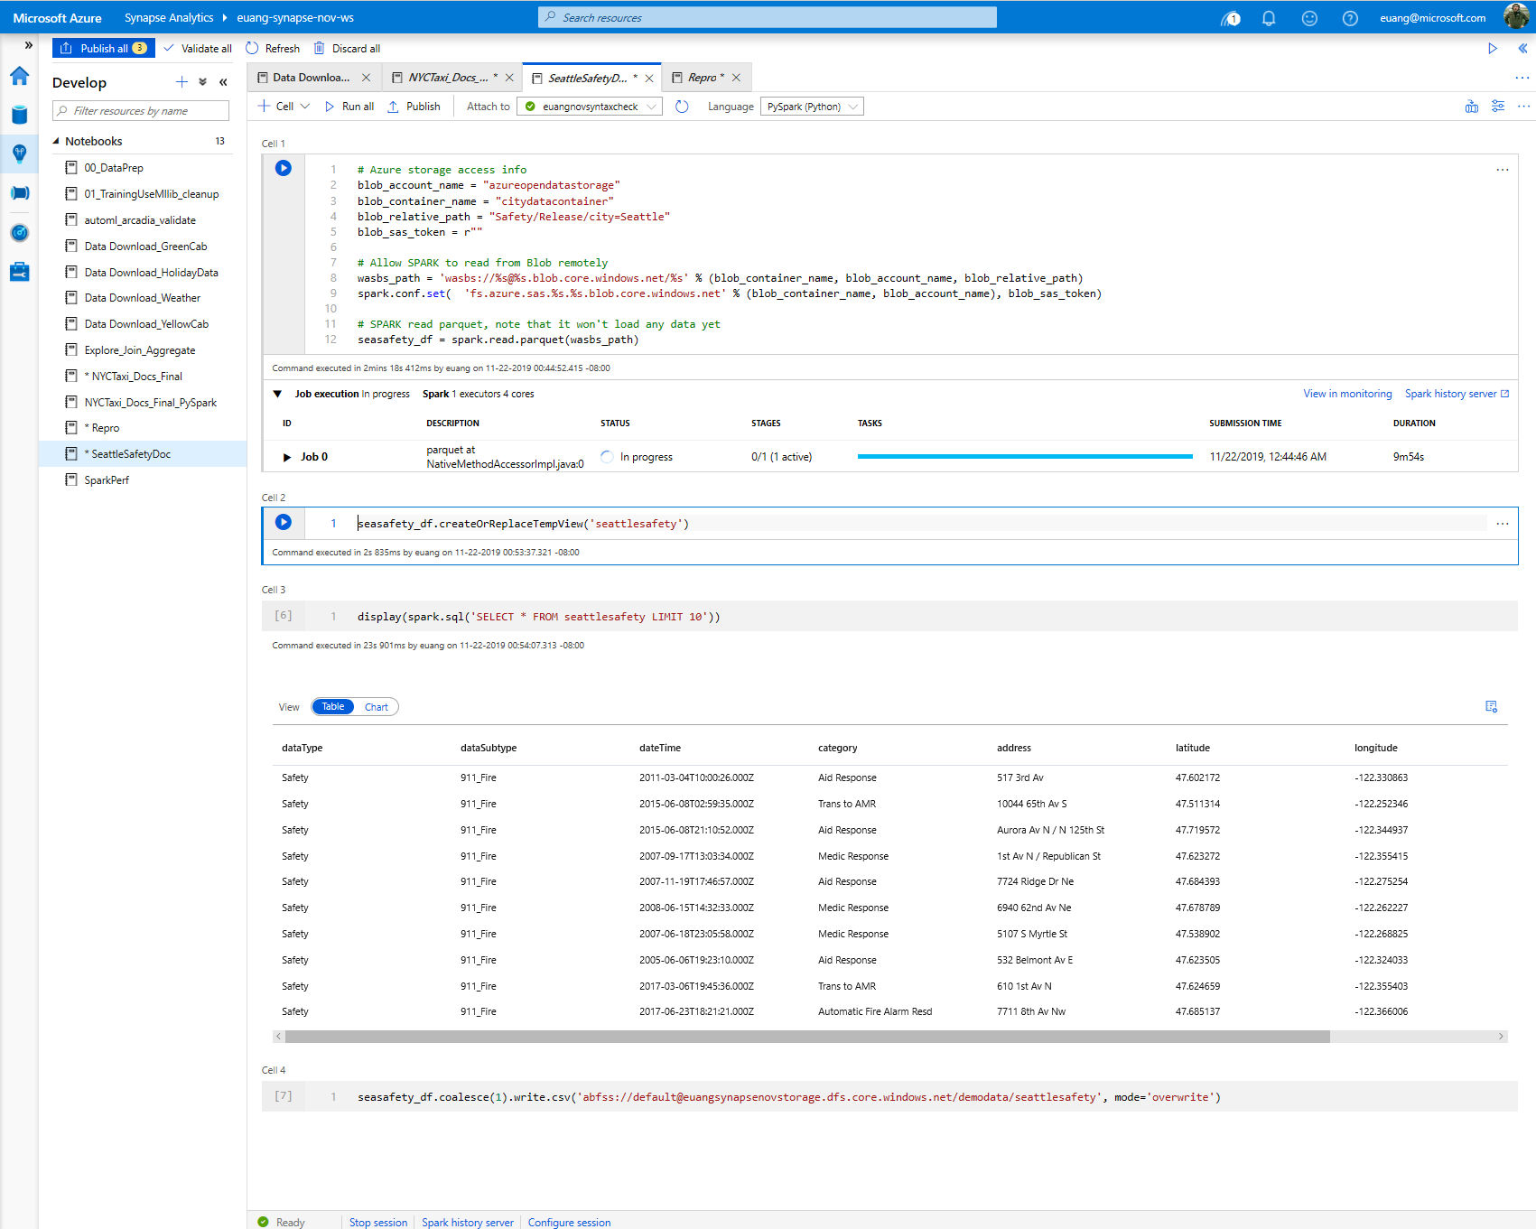
View results in table format

Slide 64
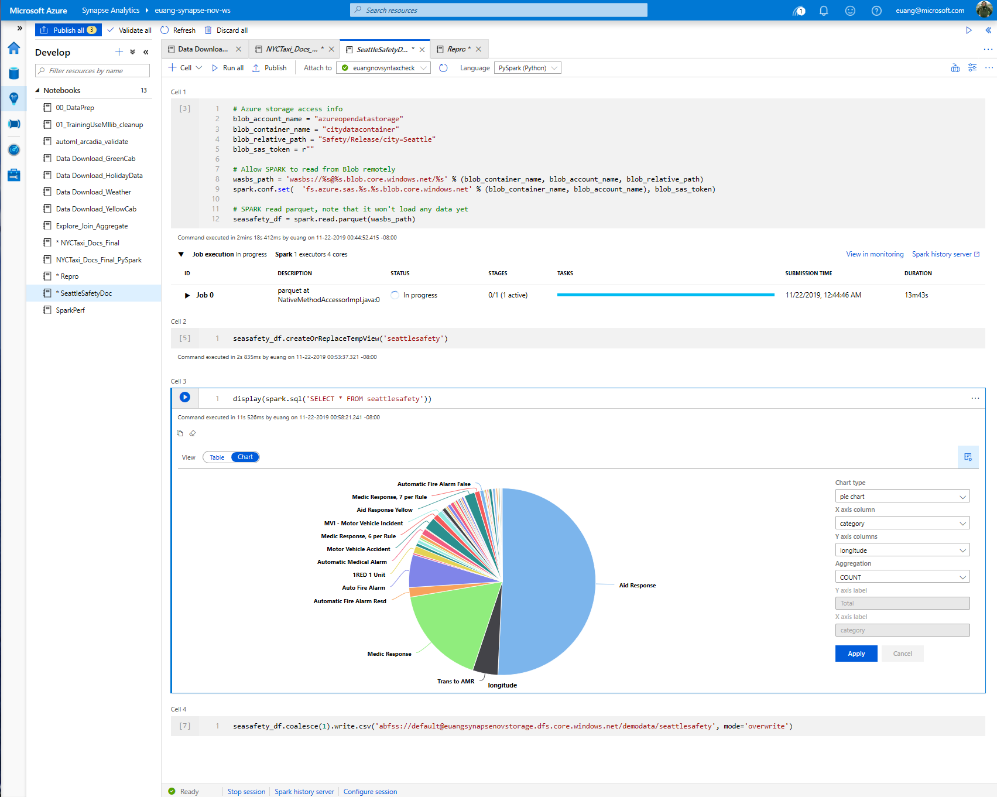
SQL support
View results in chart format

Slide 65
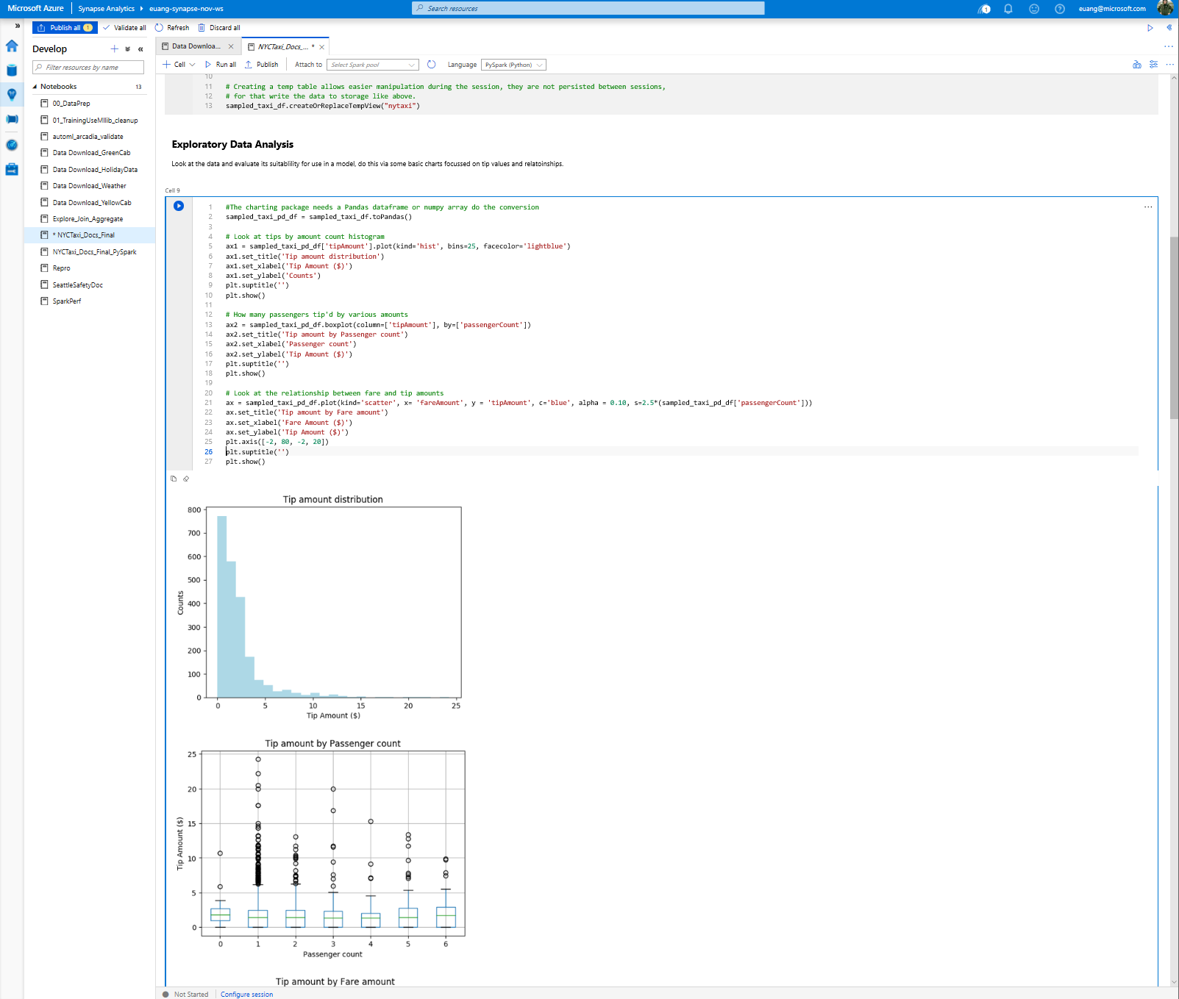
Exploratory data analysis with graphs – histogram, boxplot etc

Slide 66
Best practices

Slide 67
CCI vs Heap
Transformations using Heap tables are generally faster than CCI. This is because rows need to be assembled from column stores on read tables, and columnar compression is needed on targets.
The wider the table, and the more text fields it contains, the faster Heap is over CCI.
Use Heap tables at transformation layer, use CCI tables where appropriate at presentation layer

Slide 68
CCI Best Practice
MAX data types not supported
At least 1 million rows * 60 distributions * number of partitions
At least 100k rows per batch, up to 1million
Load using at least LARGERC or STATICRC60
Create a loading user
Minimal UPDATE and DELETE (or REBUILD frequently)

Slide 69
Automatic statistics management – Dedicated SQL
-- Turn on/off auto-create statistics settings
ALTER DATABASE {database_name}
SET AUTO_CREATE_STATISTICS { ON | OFF }
-- Turn on/off auto-update statistics settings
ALTER DATABASE {database_name}
SET AUTO_UPDATE_STATISTICS { ON | OFF }
-- Configure synchronous/asynchronous update
ALTER DATABASE {database_name}
SET AUTO_UPDATE_STATISTICS_ASYNC { ON | OFF }
-- Check statistics settings for a database
SELECT is_auto_create_stats_on,
is_auto_update_stats_on,
is_auto_update_stats_async_on
FROM sys.databases
Overview
Statistics are automatically created and maintained for dedicated SQL pool. Incoming queries are analyzed, and individual column statistics are generated on the columns that improve cardinality estimates to enhance query performance.
Statistics are automatically updated as data modifications occur in underlying tables. By default, these updates are synchronous but can be configured to be asynchronous.
Statistics are considered out of date when:
There was a data change on an empty table
The number of rows in the table at time of statistics creation was 500 or less, and more than 500 rows have been updated
The number of rows in the table at time of statistics creation was more than 500, and more than 500 + 20% of rows have been updated
Notes:
Statistics synchronous option to be asynchronous
Recalculated when there are changes over 500 rows or 20% of rows are updated
By default, auto update statistics are configured to be synchronous but can be configured to be asynchronous operations
Statistics are updated opportunistically when queries are run.

Slide 70
Statistics (serverless SQL)
Automatic creation available only for Parquet and CSV support
Same goes for recreation of statistics
Only single-column statistics are currently supported
CSV sampling not supported yet (only FULLSCAN)
Notes:
CSV support added [Cost management for serverless SQL pool - Azure Synapse Analytics | Microsoft Docs]
When statistics are created for a Parquet column, only the relevant column is read from files. When statistics are created for a CSV column, whole files are read and parsed.

Slide 71
CTAS vs Insert / Update / Delete / Merge
Prefer CTAS when you update or delete more than 10% of rows
Prefer CTAS when you are updating or deleting a clustered Columnstore index, and do not have time for an offline rebuild

Slide 72
UPDATE FROM and DELETE FROM
Azure Synapse Analytics does not currently support (*) joins in UPDATE FROM and DELETE FROM queries.
Implement the join as a temporary / transient table, then UPDATE / DELETE from that table
(*) Coming soon

Slide 73
Simple is better than clever
Persist standard columns early, to avoid calculations and functions in WHERE clause
Unroll CTEs and JOIN sub-selects to transient / temporary tables to manage distribution
Simple queries are easier to tune and debug

Slide 74
Pop Quiz #2
What is the optimal size for a rowgroup in columnstore format in a Synapse SQL Pool?
A)
99,999
B)
60,000,000
C)
1,048,576

Slide 75
Pop Quiz #2
What is the optimal size for a rowgroup in columnstore format in a Synapse SQL Pool?
A)
99,999
B)
60,000,000
C)
1,048,576
Notes:
1,048,576 – this is why we recommend at least 60 million rows for a CCI table. Azure Synapse automatically distributes data into 60 distribution, and each distribution needs at least 1 million rows for good rowgroup compression (or each partition, if your table is partitioned).

Slide 76
Modern Data Warehouse
INGEST
PREPARE
TRANSFORM & ENRICH
SERVE
VISUALIZE
AZURE SYNAPSE ANALYTICS
Synapse SQL (Provisioned)
Synapse Pipeline
Synapse SQL (Provisioned)
Data Sources
Synapse SQL (Serverless)
Synapse Pipeline
Power BI
OR
OR
Synapse Pipelines
Synapse SQL (Serverless)
Synapse Spark
Synapse Spark
Synapse SQL (Serverless)
STORE
ADLS Gen 2
Storage Account
Data Lake

Slide 77
Thank You slide
Thank you

Slide 78

Break
Please take this time for a short 15-minute break
Relax and come back refreshed for our next activity
If at anytime you require assistance, please send a message to the “Need help – ask here” channel in the Microsoft Teams site for this event

Slide 79
DW Optimization

Slide 80
Agenda
1 Performance Patterns
Result set caching and materialized views.
2 Table design
Clustered columnstore index and ordered variant, clustered index, heap and non-clustered index.
3 Index design
Clustered columnstore index and ordered variant, clustered index, heap and non-clustered index.

Slide 81
Azure Synapse Analytics
Limitless analytics service with unmatched time to insight
Artificial Intelligence / Machine Learning / Internet of Things
Intelligent Apps / Business Intelligence
Designed for analytics workloads at any scale
Synapse Analytics
SaaS developer experiences for code free and code first
Experience
Synapse Analytics Studio
Platform
Multiple languages suited to different analytics workloads
MANAGEMENT
Languages
MANAGEMENT
SQL
Python
.NET
Java
Scala
Integrated analytics runtimes available dedicated and serverless
Synapse SQL offering T-SQL for batch, streaming and interactive processing
Apache Spark for big data processing with Python, Scala and .NET
SECURITY
Form Factors
SECURITY
DEDICATED
SERVERLESS
MONITORING
Analytics Runtimes
MONITORING
SQL
METASTORE
METASTORE
DATA INTEGRATION
Integrated platform services for, management, security, monitoring, and meta-store
Azure
Data Lake Storage
Common Data Model
Enterprise Security
Optimized for Analytics
Data lake integrated and Common Data Model aware

Slide 82

Comprehensive SQL functionality
Advanced storage system
Columnstore Indexes
Table partitions
Distributed tables
Isolation modes
Materialized Views
Nonclustered Indexes
Result-set caching
T-SQL Querying
Windowing aggregates
Approximate execution (Hyperloglog)
JSON data support
Score machine learning models in ONNX format
Complete SQL object model
Tables
Views
Stored procedures
Functions

Slide 83


Question…
What is the primary factor for Azure Synapse winning a POC?
What about losing a POC?
Notes:
Answer: PERFORMANCE for both! A well designed and optimized Azure Synapse can blow away the competition but falling prey to common performance pitfalls can hurt our chances.

Slide 84
Performance Patterns

Slide 85
Result set caching motivated
Use result-set caching to improve query performance when the same queries are executed repeatedly against mainly static data.
Result-set cache is invalidated and refreshed when underlying table data changes or the query code changes
Result-set cache persists when SQL Pool is paused and resumed.
Notes:
Their downstream reports are used by many users, which often means the same query is being executed repeatedly against data that does not change that often. What can WWI to improve the performance of these types of queries? How does this approach work when the underlying data changes?
They should consider result-set caching.
Cache the results of a query in provisioned Azure Synapse SQL Pool storage. This enables interactive response times for repetitive queries against tables with infrequent data changes.
The result-set cache persists even if SQL pool is paused and resumed later.
Query cache is invalidated and refreshed when underlying table data or query code changes.
Result cache is evicted regularly based on a time-aware least recently used algorithm (TLRU).

Slide 86
Result-set caching
Overview
Cache the results of a query in SQL pool storage. This enables interactive response times for repetitive queries against tables with infrequent data changes.
The result-set cache persists even if SQL pool is paused and resumed later.
Query cache is invalidated and refreshed when underlying table data or query code changes.
Result cache is evicted regularly based on a time-aware least recently used algorithm (TLRU).
Benefits
Enhances performance when same result is requested repetitively
Reduced load on server for repeated queries
Offers monitoring of query execution with a result cache hit or miss
-- Turn on/off result-set caching for a database
-- Must be run on the MASTER database
ALTER DATABASE {database_name}
SET RESULT_SET_CACHING { ON | OFF }
-- Turn on/off result-set caching for a client session
-- Run on target Azure Synapse Analytics
SET RESULT_SET_CACHING {ON | OFF}
-- Check result-set caching setting for a database
-- Run on target Azure Synapse Analytics
SELECT is_result_set_caching_on
FROM sys.databases
WHERE name = {database_name}
-- Return all query requests with cache hits
-- Run on target data warehouse
SELECT *
FROM sys.dm_pdw_request_steps
WHERE command like '%DWResultCacheDb%'
AND step_index = 0
Notes:
Result-set caching
The maximum size of the result-set cache is 1TB
Query results are persisted for a maximum of 48 hours but can be evicted earlier to save space based on the least recently used result
Disabled on DW by default unless turned on at a session level or the entire database level
Additional storage costs are incurred by caching query result sets
Check the is_result_set_caching column in the sys.databases DMV to show the result-set caching setting for a database
Users can tell if a query was executed with a result cache hit or miss by querying sys.pdw_request_steps for commands where value is like ‘%DWResultCacheDb%’

Slide 87



Result-set caching flow
01010100010100101010
01010100010100101010
1
Client sends query to SQL pool
2
Query is processed using compute nodes which pull data from remote storage, process query and output back to client app
Query results are cached in remote storage so subsequent requests can be served immediately
01010100010100101010
3
Subsequent executions for the same query bypass compute nodes and can be fetched instantly from persistent cache in remote storage
4
Remote storage cache is evicted regularly based on time, cache usage, and any modifications to underlying table data.
5
Cache will need to be regenerated if query results have been evicted from cache
Notes:
Result-set caching
The maximum size of the result-set cache is 1TB
Query results are persisted for a maximum of 48 hours but can be evicted earlier to save space based on the least recently used result
Disabled on DW by default unless turned on at a session level or the entire database level
Additional storage costs are incurred by caching query result sets
Check the is_result_set_caching column in the sys.databases DMV to show the result-set caching setting for a database
Users can tell if a query was executed with a result cache hit or miss by querying sys.pdw_request_steps for commands where value is like ‘%DWResultCacheDb%’

Slide 88
Materialized views
-- Create indexed view
CREATE MATERIALIZED VIEW Sales.vw_Orders
WITH
(
DISTRIBUTION = ROUND_ROBIN |
HASH(ProductID)
)
AS
SELECT SUM(UnitPrice*OrderQty) AS Revenue,
OrderDate,
ProductID,
COUNT_BIG(*) AS OrderCount
FROM Sales.SalesOrderDetail
GROUP BY OrderDate, ProductID;
GO
-- Disable index view and put it in suspended mode
ALTER INDEX ALL ON Sales.vw_Orders DISABLE;
-- Re-enable index view by rebuilding it
ALTER INDEX ALL ON Sales.vw_Orders REBUILD;
Overview
A materialized view pre-computes, stores, and maintains its data like a table.
Materialized views are automatically updated when data in underlying tables are changed. This is a synchronous operation that occurs as soon as the data is changed.
The auto caching functionality allows Azure Synapse Analytics Query Optimizer to consider using indexed view even if the view is not referenced in the query.
Supported aggregations: MAX, MIN, AVG, COUNT, COUNT_BIG, SUM, VAR, STDEV
Benefits
Automatic and synchronous data refresh with data changes in base tables. No user action is required.
High availability and resiliency as regular tables
Notes:
Current Limitations:
If MIN/MAX aggregates are used in the SELECT list, the indexed view will automatically be disabled when UPDATE and DELETE occur in the referenced base tables. Run ALTER INDEX with REBUILD to re-enable the indexed view
Only INNER JOIN is supported
Only HASH and ROUND_ROBIN distributions are supported
Only CLUSTERED COLUMNSTORE INDEX is supported
ALTER VIEW is not supported

Slide 89
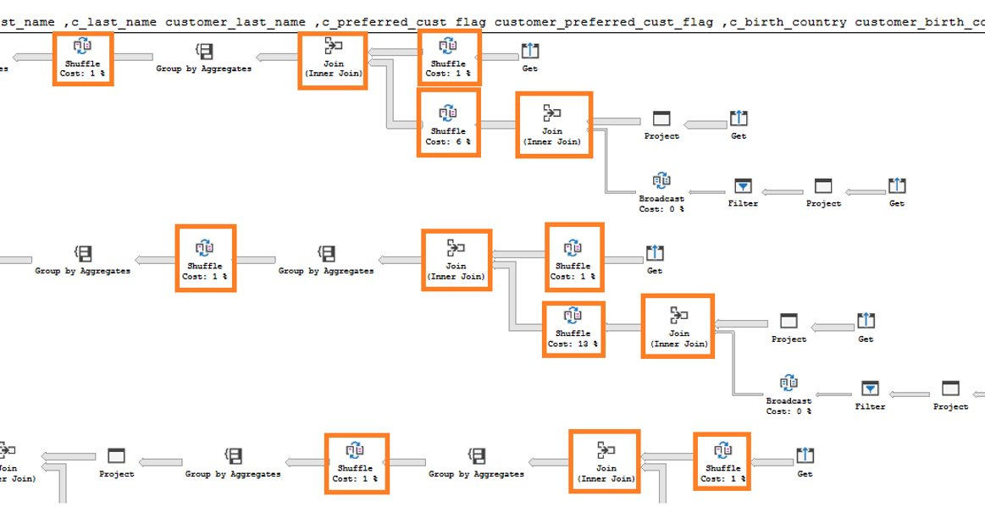
Materialized views - example
In this example, a query to get the year total sales per customer is shown to have a lot of data shuffles and joins that contribute to slow performance:
No relevant indexed views created on the data warehouse
Execution time: 103 seconds Lots of data shuffles and joins needed to complete query
-- Get year total sales per customer
(WITH year_total AS
SELECT customer_id,​
first_name,​
last_name,
birth_country, login,
email_address​,
d_year,
SUM(ISNULL(list_price – wholesale_cost – discount_amt + sales_price, 0)/2)year_total​
FROM customer cust
JOIN catalog_sales sales ON cust.sk = sales.sk
JOIN date_dim ON sales.sold_date = date_dim.date
GROUP BY customer_id​, first_name​, last_name​,birth_country​, login​,email_address​ ,d_year​
)
SELECT TOP 100 …
FROM year_total …
WHERE …
ORDER BY …

Slide 90
Indexed Materialized views - example
Now, we add an indexed view to the data warehouse to increase the performance of the previous query. This view can be leveraged by the query even though it is not directly referenced.
Original query – get year total sales per customer
Create indexed view with hash distribution on customer_id column
-- Get year total sales per customer
(WITH year_total AS
SELECT customer_id,​
first_name,​
last_name,
birth_country, login,
email_address​,
d_year,
SUM(ISNULL(list_price – wholesale_cost – discount_amt + sales_price, 0)/2)year_total​
FROM customer cust
JOIN catalog_sales sales ON cust.sk = sales.sk
JOIN date_dim ON sales.sold_date = date_dim.date
GROUP BY customer_id​, first_name​, last_name​,birth_country​, login​,email_address​ ,d_year​
)
SELECT TOP 100 …
FROM year_total …
WHERE …
ORDER BY …
-- Create indexed view for query
CREATE INDEXED VIEW nbViewCS WITH (DISTRIBUTION=HASH(customer_id)) AS
SELECT customer_id,​
first_name,​
last_name,
birth_country, login,
email_address​,
d_year,
SUM(ISNULL(list_price – wholesale_cost – discount_amt +
sales_price, 0)/2) AS year_total​
FROM customer cust
JOIN catalog_sales sales ON cust.sk = sales.sk
JOIN date_dim ON sales.sold_date = date_dim.date
GROUP BY customer_id​, first_name​,
last_name​,birth_country​,
login​, email_address​, d_year​

Slide 91
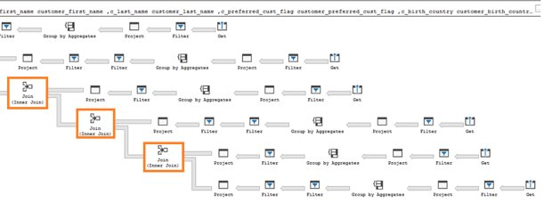
Indexed (materialized) views - example
SQL pool query optimizer automatically leverages the indexed view to speed up the same query. Notice that the query does not need to reference the view directly
Execution time: 6 seconds Optimizer leverages materialized view to reduce data shuffles and joins needed
Original query – no changes have been made to query
-- Get year total sales per customer
(WITH year_total AS
SELECT customer_id,​
first_name,​
last_name,
birth_country, login,
email_address​,
d_year,
SUM(ISNULL(list_price – wholesale_cost – discount_amt + sales_price, 0)/2)year_total​
FROM customer cust
JOIN catalog_sales sales ON cust.sk = sales.sk
JOIN date_dim ON sales.sold_date = date_dim.date
GROUP BY customer_id​, first_name​, last_name​,birth_country​, login​,email_address​ ,d_year​
)
SELECT TOP 100 …
FROM year_total …
WHERE …
ORDER BY …

Slide 92
Materialized views- Recommendations
EXPLAIN - provides query plan for SQL statement without running the statement; view estimated cost of the query operations.
EXPLAIN WITH_RECOMMENDATIONS - provides query plan with recommendations to optimize the SQL statement performance.
EXPLAIN WITH_RECOMMENDATIONS
select count(*)
from (
(select distinct c_last_name, c_first_name, d_date
from store_sales, date_dim, customer
where store_sales.ss_sold_date_sk = date_dim.d_date_sk
and store_sales.ss_customer_sk = customer.c_customer_sk
and d_month_seq between 1194 and 1194+11)
except
(select distinct c_last_name, c_first_name, d_date
from catalog_sales, date_dim, customer
where catalog_sales.cs_sold_date_sk = date_dim.d_date_sk
and catalog_sales.cs_bill_customer_sk = customer.c_customer_sk and d_month_seq between 1194 and 1194+11)
) top_customers

Slide 93
Indexed Materialized Views
Indexed views cache the schema and data for a view in DW remote storage. They are useful for improving the performance of ‘SELECT’ statement queries that include aggregations
Indexed views are automatically updated when data in underlying tables are changed. This is a synchronous operation that occurs as soon as the data is changed.
The auto caching functionality allows Synapse Query Optimizer to consider using indexed view even if the view is not referenced in the query
Supported aggregations: MAX, MIN, AVG, COUNT, COUNT_BIG, SUM, VAR, STDEV

Slide 94
Table design

Slide 95
Tables – Distributions
CREATE TABLE dbo.OrderTable
(
OrderId INT NOT NULL,
Date DATE NOT NULL,
Name VARCHAR(2),
Country VARCHAR(2)
)
WITH
(
CLUSTERED COLUMNSTORE INDEX,
DISTRIBUTION = HASH([OrderId]) |
ROUND ROBIN |
REPLICATED
);
Round-robin distributed
Distributes table rows evenly across all distributions at random.
Hash distributed
Distributes table rows across the Compute nodes by using a deterministic hash function to assign each row to one distribution.
Replicated
Full copy of table accessible on each Compute node.
Notes:
A distributed table appears as a single table, but the rows are actually stored across 60 distributions. The rows are distributed with a hash or round-robin algorithm.
Hash distributed
A hash-distributed table distributes table rows across the Compute nodes by using a deterministic hash function to assign each row to one distribution.
Since identical values always hash to the same distribution, the data warehouse has built-in knowledge of the row locations. SQL Data Warehouse uses this knowledge to minimize data movement during queries, which improves query performance.
Hash-distributed tables work well for large fact tables in a star schema. They can have very large numbers of rows and still achieve high performance. There are, of course, some design considerations that help you to get the performance the distributed system is designed to provide. Choosing a good distribution column is one such consideration that is described in this article.
Consider using a hash-distributed table when:
The table size on disk is more than 2 GB.
The table has frequent insert, update, and delete operations.
Round-robin distributed
A round-robin distributed table distributes table rows evenly across all distributions. The assignment of rows to distributions is random. Unlike hash-distributed tables, rows with equal values are not guaranteed to be assigned to the same distribution.
As a result, the system sometimes needs to invoke a data movement operation to better organize your data before it can resolve a query. This extra step can slow down your queries. For example, joining a round-robin table usually requires reshuffling the rows, which is a performance hit.
Consider using the round-robin distribution for your table in the following scenarios:
When getting started as a simple starting point since it is the default
If there is no obvious joining key
If there is not good candidate column for hash distributing the table
If the table does not share a common join key with other tables
If the join is less significant than other joins in the query
When the table is a temporary staging table
Replicated Tables
A replicated table has a full copy of the table accessible on each Compute node. Replicating a table removes the need to transfer data among Compute nodes before a join or aggregation. Since the table has multiple copies, replicated tables work best when the table size is less than 2 GB compressed.
Replicated tables work well for small dimension tables in a star schema. Dimension tables are usually of a size that makes it feasible to store and maintain multiple copies. Dimensions store descriptive data that changes slowly, such as customer name and address, and product details. The slowly changing nature of the data leads to fewer rebuilds of the replicated table.
Consider using a replicated table when:
The table size on disk is less than 2 GB, regardless of the number of rows. To find the size of a table, you can use the DBCC PDW_SHOWSPACEUSED command: DBCC PDW_SHOWSPACEUSED('ReplTableCandidate').
The table is used in joins that would otherwise require data movement. When joining tables that are not distributed on the same column, such as a hash-distributed table to a round-robin table, data movement is required to complete the query. If one of the tables is small, consider a replicated table. We recommend using replicated tables instead of round-robin tables in most cases. To view data movement operations in query plans, use sys.dm_pdw_request_steps. The BroadcastMoveOperation is the typical data movement operation that can be eliminated by using a replicated table.
Source: https://docs.microsoft.com/en-us/azure/sql-data-warehouse/sql-data-warehouse-tables-distribute
https://docs.microsoft.com/en-us/azure/sql-data-warehouse/design-guidance-for-replicated-tables

Slide 96
Tables – Partitions
Overview
Table partitions divide data into smaller groups
In most cases, partitions are created on a date column
Supported on all table types
RANGE RIGHT – Used for time partitions
RANGE LEFT – Used for number partitions
Benefits
Improves efficiency and performance of loading and querying by limiting the scope to subset of data.
Offers significant query performance enhancements where filtering on the partition key can eliminate unnecessary scans and eliminate IO.
CREATE TABLE partitionedOrderTable
(
OrderId INT NOT NULL,
Date DATE NOT NULL,
Name VARCHAR(2),
Country VARCHAR(2)
)
WITH
(
CLUSTERED COLUMNSTORE INDEX,
DISTRIBUTION = HASH([OrderId]),
PARTITION (
[Date] RANGE RIGHT FOR VALUES (
'2000-01-01', '2001-01-01', '2002-01-01’,
'2003-01-01', '2004-01-01', '2005-01-01'
)
)
);
Notes:
What are table partitions?
Table partitions enable you to divide your data into smaller groups of data. In most cases, table partitions are created on a date column. Partitioning is supported on all SQL Data Warehouse table types; including clustered columnstore, clustered index, and heap. Partitioning is also supported on all distribution types, including both hash or round robin distributed.
Partitioning can benefit data maintenance and query performance. Whether it benefits both or just one is dependent on how data is loaded and whether the same column can be used for both purposes, since partitioning can only be done on one column.
Benefits to loads
The primary benefit of partitioning in SQL Data Warehouse is to improve the efficiency and performance of loading data by use of partition deletion, switching and merging. In most cases data is partitioned on a date column that is closely tied to the order in which the data is loaded into the database. One of the greatest benefits of using partitions to maintain data it the avoidance of transaction logging. While simply inserting, updating, or deleting data can be the most straightforward approach, with a little thought and effort, using partitioning during your load process can substantially improve performance.
Partition switching can be used to quickly remove or replace a section of a table. For example, a sales fact table might contain just data for the past 36 months. At the end of every month, the oldest month of sales data is deleted from the table. This data could be deleted by using a delete statement to delete the data for the oldest month. However, deleting a large amount of data row-by-row with a delete statement can take too much time, as well as create the risk of large transactions that take a long time to rollback if something goes wrong. A more optimal approach is to drop the oldest partition of data. Where deleting the individual rows could take hours, deleting an entire partition could take seconds.
Benefits to queries
Partitioning can also be used to improve query performance. A query that applies a filter to partitioned data can limit the scan to only the qualifying partitions. This method of filtering can avoid a full table scan and only scan a smaller subset of data. With the introduction of clustered columnstore indexes, the predicate elimination performance benefits are less beneficial, but in some cases there can be a benefit to queries. For example, if the sales fact table is partitioned into 36 months using the sales date field, then queries that filter on the sale date can skip searching in partitions that don’t match the filter.
Sizing partitions
While partitioning can be used to improve performance some scenarios, creating a table with too many partitions can hurt performance under some circumstances. These concerns are especially true for clustered columnstore tables. For partitioning to be helpful, it is important to understand when to use partitioning and the number of partitions to create. There is no hard fast rule as to how many partitions are too many, it depends on your data and how many partitions you loading simultaneously. A successful partitioning scheme usually has tens to hundreds of partitions, not thousands.
When creating partitions on clustered columnstore tables, it is important to consider how many rows belong to each partition. For optimal compression and performance of clustered columnstore tables, a minimum of 1 million rows per distribution and partition is needed. Before partitions are created, SQL Data Warehouse already divides each table into 60 distributed databases. Any partitioning added to a table is in addition to the distributions created behind the scenes. Using this example, if the sales fact table contained 36 monthly partitions, and given that SQL Data Warehouse has 60 distributions, then the sales fact table should contain 60 million rows per month, or 2.1 billion rows when all months are populated. If a table contains fewer than the recommended minimum number of rows per partition, consider using fewer partitions in order to increase the number of rows per partition. For more information, see the Indexing article, which includes queries that can assess the quality of cluster columnstore indexes.
Source: https://docs.microsoft.com/en-us/azure/sql-data-warehouse/sql-data-warehouse-tables-partition

Slide 97
Tables – Distributions & Partitions
Logical table structure
Physical data distribution ( Hash distribution (OrderId), Date partitions )
OrderId | Date | Name | Country
85016 | 11-2-2018 | V | UK
85018 | 11-2-2018 | Q | SP
85216 | 11-2-2018 | Q | DE
85395 | 11-2-2018 | V | NL
82147 | 11-2-2018 | Q | FR
86881 | 11-2-2018 | D | UK
93080 | 11-3-2018 | R | UK
94156 | 11-3-2018 | S | FR
96250 | 11-3-2018 | Q | NL
98799 | 11-3-2018 | R | NL
98015 | 11-3-2018 | T | UK
98310 | 11-3-2018 | D | DE
98979 | 11-3-2018 | Z | DE
98137 | 11-3-2018 | T | FR
… | … | … | …
Distribution1 (OrderId 80,000 – 100,000)
11-2-2018 partition
OrderId | Date | Name | Country
85016 | 11-2-2018 | V | UK
85018 | 11-2-2018 | Q | SP
85216 | 11-2-2018 | Q | DE
85395 | 11-2-2018 | V | NL
82147 | 11-2-2018 | Q | FR
86881 | 11-2-2018 | D | UK
… | … | … | …
…
x 60 distributions (shards)
Each shard is partitioned with the same date partitions
A minimum of 1 million rows per distribution and partition is needed for optimal compression and performance of clustered Columnstore tables
11-3-2018 partition
OrderId | Date | Name | Country
93080 | 11-3-2018 | R | UK
94156 | 11-3-2018 | S | FR
96250 | 11-3-2018 | Q | NL
98799 | 11-3-2018 | R | NL
98015 | 11-3-2018 | T | UK
98310 | 11-3-2018 | D | DE
98979 | 11-3-2018 | Z | DE
98137 | 11-3-2018 | T | FR
… | … | … | …

Slide 98
Common table distribution methods
Table Category | Recommended Distribution Option
Fact | Use hash-distribution with clustered columnstore index. Performance improves because hashing enables the platform to localize certain operations within the node itself during query execution. Operations that benefit: COUNT(DISTINCT( <hashed_key> )) OVER PARTITION BY <hashed_key> most JOIN <table_name> ON <hashed_key> GROUP BY <hashed_key>
Dimension | Use replicated for smaller tables. If tables are too large to store on each Compute node, use hash-distributed.
Staging | Use round-robin for the staging table. The load with CTAS is faster. Once the data is in the staging table, use INSERT…SELECT to move the data to production tables.

Slide 99
Question…
Why is the best practice to load into a staging table, and then CTAS into the production table?
Notes:
Answer: Because the risky part of the load is moving data from external storage into the SQL Pool – loading into a staging table (round robin/heap) ensures that the riskiest part of the load happens the fastest!

Slide 100
Performance Patterns

Slide 101
Distributed table design recommendations
Hash Distribution:
Large fact tables exceeding several GBs with frequent inserts should use a hash distribution.
Round Robin Distribution:
Potentially useful tables created from raw input.
Temporary staging tables used in data preparation.
Replicated Tables:
Lookup tables that range in size from 100’s MBs to 1.5 GBs should be replicated. Works best when table size is less than 2 GB compressed.
Notes:
What are the typical issues they should look out for with regards to distributed table design for the following scenarios?
Their smallest fact table exceeds several GB’s and by their nature experiences frequent inserts.
They should use a hash distribution.
A hash-distributed table distributes table rows across the Compute nodes by using a deterministic hash function to assign each row to one distribution.
Since identical values always hash to the same distribution, the data warehouse has built-in knowledge of the row locations. SQL Data Warehouse uses this knowledge to minimize data movement during queries, which improves query performance.
Hash-distributed tables work well for large fact tables in a star schema. They can have very large numbers of rows and still achieve high performance.
Consider using a hash-distributed table when:
The table size on disk is more than 2 GB.
The table has frequent insert, update, and delete operations.
As they develop the data warehouse, the WWI data team identified some tables created from the raw input that might be useful, but they don’t currently join to other tables and they are not sure of the best columns they should use for distributing the data.
They should consider round-robin distribution.
A round-robin distributed table distributes table rows evenly across all distributions. The assignment of rows to distributions is random. Unlike hash-distributed tables, rows with equal values are not guaranteed to be assigned to the same distribution.
As a result, the system sometimes needs to invoke a data movement operation to better organize your data before it can resolve a query. This extra step can slow down your queries. For example, joining a round-robin table usually requires reshuffling the rows, which is a performance hit.
Consider using the round-robin distribution for your table in the following scenarios:
When getting started as a simple starting point since it is the default
If there is no obvious joining key
If there is not good candidate column for hash distributing the table
If the table does not share a common join key with other tables
If the join is less significant than other joins in the query
When the table is a temporary staging table
Their data engineers sometimes use temporary staging tables in their data preparation.
They should use a round-robin distributed table.
They have lookup tables that range from several hundred MBs to 1.5 GBs.
They should consider using replicated tables.
A replicated table has a full copy of the table accessible on each Compute node. Replicating a table removes the need to transfer data among Compute nodes before a join or aggregation. Since the table has multiple copies, replicated tables work best when the table size is less than 2 GB compressed.

Slide 102
Automatic statistics management – Dedicated SQL
-- Turn on/off auto-create statistics settings
ALTER DATABASE {database_name}
SET AUTO_CREATE_STATISTICS { ON | OFF }
-- Turn on/off auto-update statistics settings
ALTER DATABASE {database_name}
SET AUTO_UPDATE_STATISTICS { ON | OFF }
-- Configure synchronous/asynchronous update
ALTER DATABASE {database_name}
SET AUTO_UPDATE_STATISTICS_ASYNC { ON | OFF }
-- Check statistics settings for a database
SELECT is_auto_create_stats_on,
is_auto_update_stats_on,
is_auto_update_stats_async_on
FROM sys.databases
Overview
Statistics are automatically created and maintained for dedicated SQL pool. Incoming queries are analyzed, and individual column statistics are generated on the columns that improve cardinality estimates to enhance query performance.
Statistics are automatically updated as data modifications occur in underlying tables. By default, these updates are synchronous but can be configured to be asynchronous.
Statistics are considered out of date when:
There was a data change on an empty table
The number of rows in the table at time of statistics creation was 500 or less, and more than 500 rows have been updated
The number of rows in the table at time of statistics creation was more than 500, and more than 500 + 20% of rows have been updated
Notes:
Statistics synchronous option to be asynchronous
Recalculated when there are changes over 500 rows or 20% of rows are updated
By default, auto update statistics are configured to be synchronous but can be configured to be asynchronous operations
Statistics are updated opportunistically when queries are run.

Slide 103
Performance Anti-Patterns

Slide 104
Too many partitions
Partitions can be useful when maintaining current rows in very large fact tables. Partition switching is a good alternative to full CTAS
Partitioning CCIs is only useful when the row count is greater than 60million * #partitions
In general, avoid partitions, particularly in POCs

Slide 105
Views on Views
Views on Views will not support performance optimization using Materialized Views (more later)
Views cannot be distributed

Slide 106


Question…
How many indexing methods are there for a Synapse table?
Can you name them all?
Notes:
Clustered Columnstore, Clustered index (and non-clustered index), Heap

Slide 107
Index design

Slide 108
Tables – Indexes
Clustered Columnstore index (Default Primary)
Highest level of data compression
Best overall query performance
Clustered index (Primary)
Performant for looking up a single to few rows
Heap (Primary)
Faster loading and landing temporary data
Best for small lookup tables
Nonclustered indexes (Secondary)
Enable ordering of multiple columns in a table
Allows multiple nonclustered on a single table
Can be created on any of the above primary indexes
More performant lookup queries
-- Create table with index
CREATE TABLE orderTable
(
OrderId INT NOT NULL,
Date DATE NOT NULL,
Name VARCHAR(2),
Country VARCHAR(2)
)
WITH
(
CLUSTERED COLUMNSTORE INDEX |
HEAP |
CLUSTERED INDEX (OrderId)
);
-- Add non-clustered index to table
CREATE INDEX NameIndex ON orderTable (Name);
Notes:
Clustered columnstore indexes
By default, SQL Data Warehouse creates a clustered columnstore index when no index options are specified on a table. Clustered columnstore tables offer both the highest level of data compression as well as the best overall query performance. Clustered columnstore tables will generally outperform clustered index or heap tables and are usually the best choice for large tables. For these reasons, clustered columnstore is the best place to start when you are unsure of how to index your table.
There are a few scenarios where clustered columnstore may not be a good option:
Columnstore tables do not support varchar(max), nvarchar(max) and varbinary(max). Consider heap or clustered index instead.
Columnstore tables may be less efficient for transient data. Consider heap and perhaps even temporary tables.
Small tables with less than 100 million rows. Consider heap tables.
Clustered and nonclustered indexes
Clustered indexes may outperform clustered columnstore tables when a single row needs to be quickly retrieved. For queries where a single or very few row lookup is required to performance with extreme speed, consider a cluster index or nonclustered secondary index. The disadvantage to using a clustered index is that only queries that benefit are the ones that use a highly selective filter on the clustered index column. To improve filter on other columns a nonclustered index can be added to other columns. However, each index which is added to a table adds both space and processing time to loads.
Heap tables
When you are temporarily landing data on SQL Data Warehouse, you may find that using a heap table makes the overall process faster. This is because loads to heaps are faster than to index tables and in some cases the subsequent read can be done from cache. If you are loading data only to stage it before running more transformations, loading the table to heap table is much faster than loading the data to a clustered columnstore table. In addition, loading data to a temporary table loads faster than loading a table to permanent storage.
For small lookup tables, less than 100 million rows, often heap tables make sense. Cluster columnstore tables begin to achieve optimal compression once there is more than 100 million rows.
Source: https://docs.microsoft.com/en-us/azure/sql-data-warehouse/sql-data-warehouse-tables-index

Slide 109
SQL Analytics Columnstore Tables
Logical table structure
Clustered columnstore index (OrderId)
Clustered/Non-clustered rowstore index (OrderId)
OrderId | Date | Name | Country
85016 | 11-2-2018 | V | UK
85018 | 11-2-2018 | Q | SP
85216 | 11-2-2018 | Q | DE
85395 | 11-2-2018 | V | NL
82147 | 11-2-2018 | Q | FR
86881 | 11-2-2018 | D | UK
93080 | 11-3-2018 | R | UK
94156 | 11-3-2018 | S | FR
96250 | 11-3-2018 | Q | NL
98799 | 11-3-2018 | R | NL
98015 | 11-3-2018 | T | UK
98310 | 11-3-2018 | D | DE
98979 | 11-3-2018 | Z | DE
98137 | 11-3-2018 | T | FR
… | … | … | …
OrderId | PageId
82147 | 1001
98137 | 1002
Rowgroup1 Min (OrderId): 82147 | Max (OrderId): 85395
OrderId
82147
85016
85018
85216
85395
Country
FR
UK
SP
DE
NL
OrderId | PageId
82147 | 1005
85395 | 1006
OrderId | PageId
98137 | 1007
98979 | 1008
…
Name
Q
V
…
…
Date
11-2-2018
OrderId | Date | Name | Country
82147 | 11-2-2018 | Q | FR
85016 | 11-2-2018 | V | UK
85018 | 11-2-2018 | Q | SP
OrderId | Date | Name | Country
98137 | 11-3-2018 | T | FR
98310 | 11-3-2018 | D | DE
98799 | 11-3-2018 | R | NL
OrderId | Date | Name | Country
82147 | 11-2-2018 | Q | FR
85016 | 11-2-2018 | V | UK
85018 | 11-2-2018 | Q | SP
OrderId | Date | Name | Country
98137 | 11-3-2018 | T | FR
98310 | 11-3-2018 | D | DE
98799 | 11-3-2018 | R | NL
+
Delta Rowstore
OrderId | Date | Name | Country
98137 | 11-3-2018 | T | FR
98310 | 11-3-2018 | D | DE
98799 | 11-3-2018 | R | NL
98979 | 11-3-2018 | Z | DE
Data is stored in a B-tree index structure for performant lookup queries for particular rows.
Clustered rowstore index: The leaf nodes in the structure store the data values in a row (as pictured above)
Non-clustered (secondary) rowstore index: The leaf nodes store pointers to the data values, not the values themselves
Data stored in compressed columnstore segments after being sliced into groups of rows (rowgroups/micro-partitions) for maximum compression
Rows are stored in the delta rowstore until the number of rows is large enough to be compressed into a columnstore
Notes:
Format slide

Slide 110
Ordered Clustered Columnstore Indexes
Overview
Queries against tables with ordered columnstore segments can take advantage of improved segment elimination to drastically reduce the time needed to service a query.
-- Create Table with Ordered Columnstore Index
CREATE TABLE sortedOrderTable
(
OrderId INT NOT NULL,
Date DATE NOT NULL,
Name VARCHAR(2),
Country VARCHAR(2)
)
WITH
(
CLUSTERED COLUMNSTORE INDEX ORDER (OrderId)
)
-- Create Clustered Columnstore Index on existing table
CREATE CLUSTERED COLUMNSTORE INDEX cciOrderId
ON dbo.OrderTable ORDER (OrderId)
-- Insert data into table with ordered columnstore index
INSERT INTO sortedOrderTable
VALUES (1, '01-01-2019','Dave’, 'UK')
Notes:
Formatting

Slide 111
Ordered CCI
Queries against tables with ordered columnstore segments can take advantage of improved segment elimination to drastically reduce the time needed to service a query.
Columnstore Segments are automatically updated as data is inserted, updated, or deleted in data warehouse tables.

Slide 112
Choosing the right index
Clustered Columnstore indexes (CCI) are best for fact tables.
CCI offer the highest level of data compression and best query performance for tables with over 100 million rows.
Heap tables are best for small lookup tables and recommended for tables with less than 100 million rows.
Clustered Indexes may outperform CCI when very few rows need to be retrieved quickly.
Add non-clustered indexes to improve performance for less selective queries.
Each additional index added to a table increases storage space required and processing time during data loads.
Speed load performance by staging data in heap tables and temporary tables prior to running transformations.
as
Notes:
Their sales transaction dataset exceeds a billion rows. For their downstream reporting queries, they need to be able to join, project and filter these rows in no longer than 10s of seconds. WWI is concerned their data is just too big to do this.
What specific indexing techniques should they use to reach this kind of performance for their fact tables? Why?
Clustered Columnstore Indexes. As they offer the highest level of data compression and best overall query performance, columnstore indexes are usually the best choice for large tables such as fact tables.
Would you recommend the same approach for tables they have with less than 100 million rows?
No. For "small" tables with less than 100 million rows, they should consider Heap tables.
How should they configure indexes on their smaller lookup tables (e.g., those that contain store names and addresses)?
They should consider using Heap tables. For small lookup tables, less than 100 million rows, often heap tables make sense. Cluster columnstore tables begin to achieve optimal compression once there is more than 100 million rows.
What would you suggest for their larger lookup tables that are used just for point lookups that retrieve only a single row? How could they makes these more flexible so that queries filtering against different sets of columns would still yield efficient lookups?
Use clustered indexes. Clustered indexes may outperform clustered columnstore tables when a single row needs to be quickly retrieved. For queries where a single or a very few number of rows to lookup is required to perform with extreme speed, consider a clustered index or non-clustered secondary index.
The disadvantage to using a clustered index is that the only queries that benefit are the ones that use a highly selective filter on the clustered index column. To improve filter performance on other columns, a non-clustered index can be added to other columns.
However, be aware that each index which is added to a table adds both space and processing time to data loads.
What should they use for the fastest loading of staging tables?
A heap table. If you are loading data only to stage it before running more transformations, loading the table to heap table is much faster than loading the data to a clustered columnstore table.
A temporary table. Loading data to a temporary table loads faster than loading a table to permanent storage.

Slide 113
Performance Anti-Patterns

Slide 114
Too many indexes
Start without indexes. The overhead of maintaining them can be greater than their value.
A primary-key non-clustered index may improve performance of joins when fact tables are joined to very large (billion+) dimensions

Slide 115




Pop Quiz
dbo.dimProduct
1.5k rows
Product information
CCI
dbo.Sales
150M rows
Single sales lookups
Heap
Match the tables with their recommended index!
dbo.LineItem
30B rows
Primary fact table
CI
stg.stagingLineItem
10k rows
Staging table for loads

Slide 116
Pop Quiz
dbo.dimProduct
1.5k rows
Product information
CCI
dbo.Sales
150M rows
Single sales lookups
Heap
Match the tables with their recommended index!
dbo.LineItem
30B rows
Primary fact table
CI
stg.stagingLineItem
10k rows
Staging table for loads

Slide 117
Modern Data Warehouse
INGEST
PREPARE
TRANSFORM & ENRICH
SERVE
VISUALIZE
AZURE SYNAPSE ANALYTICS
Synapse SQL (Provisioned)
Synapse Pipeline
Synapse SQL (Provisioned)
Data Sources
Synapse SQL (Serverless)
Synapse Pipeline
Power BI
OR
OR
Synapse Pipelines
Synapse SQL (Serverless)
Synapse Spark
Synapse Spark
Synapse SQL (Serverless)
STORE
ADLS Gen 2
Storage Account
Data Lake

Slide 118
Thank You slide
Thank you

Slide 119
Break
Please take this time for a short 15-minute break
Relax and come back refreshed for our next activity
If at anytime you require assistance, please send a message to the “Need help – ask here” channel in the Microsoft Teams site for this event

Slide 120

Your challenge should you choose to accept it:
Wide World Importers needs your help!
Work as a team and prove to them you have what it takes.
It won’t be easy alone, but as ONE Microsoft, you can do this!
Complete as many of the challenges as you can, but don’t worry about getting them all done.
This Photo by Unknown Author is licensed under CC BY

Slide 121






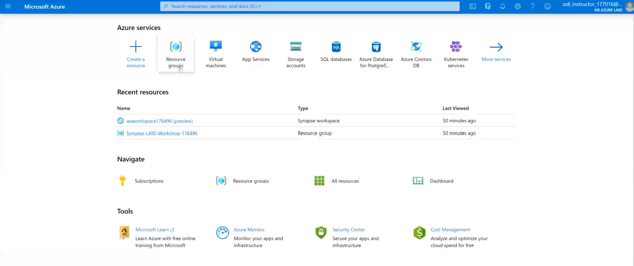

POC Challenges 1 & 2: group-based lab exercises
GUIDE:
PoC Challenge
https://github.com/solliancenet/azure-synapse-analytics-workshop-300-2-day
Step 1: Go to your table group channel
Step 2: You will use your cloud lab login for Azure
Step 3: Login to Azure. Engage your table group via a Microsoft Teams “meet now” call to collaborate with each other (meet now button in upper right corner of application)

Slide 122

Day 1 Wrap Up
Thank you for your participation in the Day 1 Technical Boot Camp
What was covered today:
Design, optimize, and secure a file system within ALDS Gen2
Decide on which Azure Synapse Analytics component to use for specific data engineering scenarios
Implement optimization strategizes for the data warehouse using SQL based approached in Azure Synapse Analytics.​
What we will learn tomorrow:
Address scenarios to monitor and manage Azure solutions
Apply security concepts to a customer scenario
If at anytime you require assistance, please send a message to the “Need help – ask here” channel in the Microsoft Teams site for this event

Slide 123

We’d love to hear from you!
Day 1
Scan the QR code below using your smartphone or access the link https://aka.ms/BC_EMEA_Day1 You’ll also receive a link to this survey by email. You only need to complete it once. Answer the survey questions to provide your feedback on Day 1 of Boot Camp. Be honest. Every bit of feedback helps us improve.

